Slide 1
Smart Investor Profile Explorer
Client Project for Zenith (Capstone Project)
Group 2:

Slide 2
OUR AGENDA
Dataset Description &
Data Preprocessing
01
04
Challenges, Limitations, Future Work
02
05
Project Summary
EDA &
Data Visualization
03
Machine Learning

Slide 3
01
Dataset Description
&
Data Preprocessing

Slide 4
Project Objective
Build a smart investor profile exploration tool based on real investor data.
Identify patterns, preferences, and actionable insights for investment decision-making.
Help Zenith better understand investor profiles.
Provide data-driven insights to discover business opportunities.
Build predictive classification models to improve matching accuracy.

Slide 5
— Business Problem
Large volume but scattered investor data
Manual analysis is time-consuming and prone to missing key opportunities
Lack of systematic classification and automated prediction capability

Slide 6
Dataset Description

Slide 7
Data Source & Size
Raw Dataset
After data cleaning & preparation
After fixing code issue
Real operational data provided by Zenith
2,330,160 records 10 core columns
135,346 records
9 core columns
28 types of Investors
204 Geography categories
16 Industry categories
155,344 records
10 core columns

Slide 8
Data Fields
Investors
Description
Geography
Preferred Industry
Preferred Investment Type
Primary Investor Type
geography_tags
preferred_investment_type_tags
preferred_industry_tags

Slide 9
Data Preprocessing

Slide 10
Data Cleaning & Preparation
Remove duplicates & invalid records
Handle missing values： (e.g. ‘www.’, ‘’, ‘[0]’)
1
2
4
3
Standardize textual tags into structured fields
Cleaned Dataset: 136,277 rows × 9 columns
Data Insights (EDA)

Slide 11
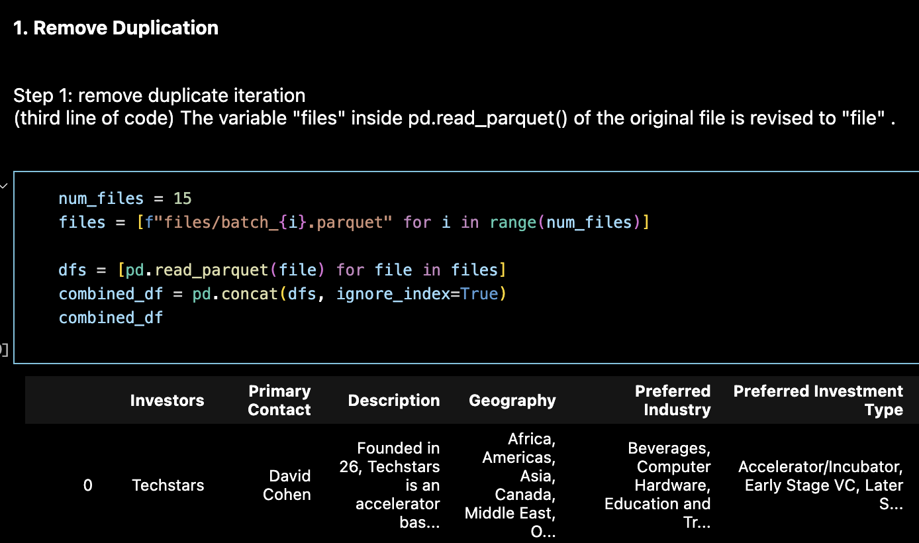
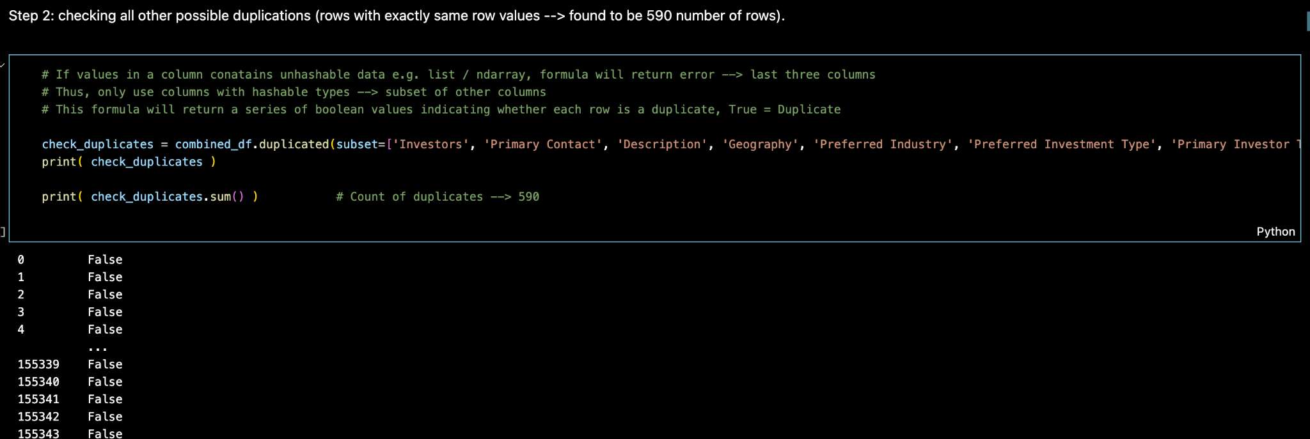
Remove duplicates & invalid records

Slide 12
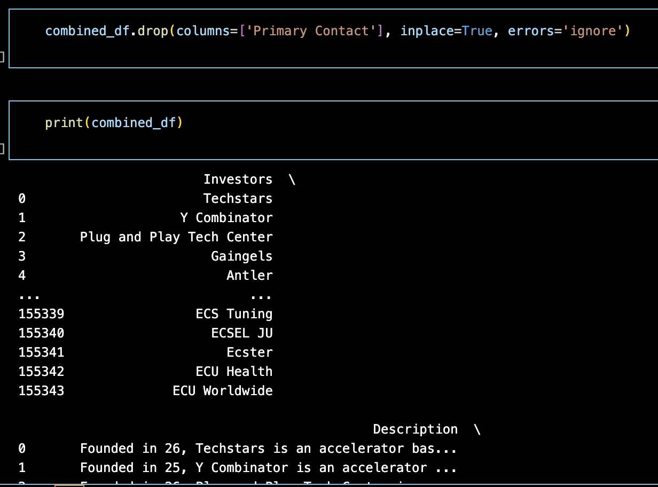
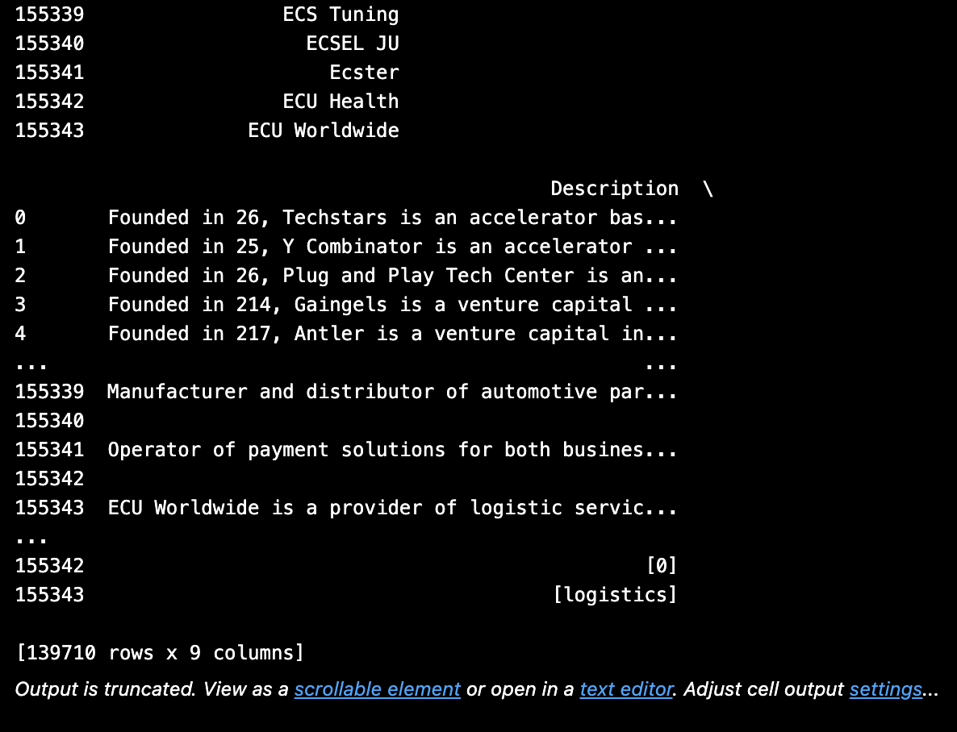
Handle missing values
e.g. ‘www.’, ‘’, ‘[0]’

Slide 13
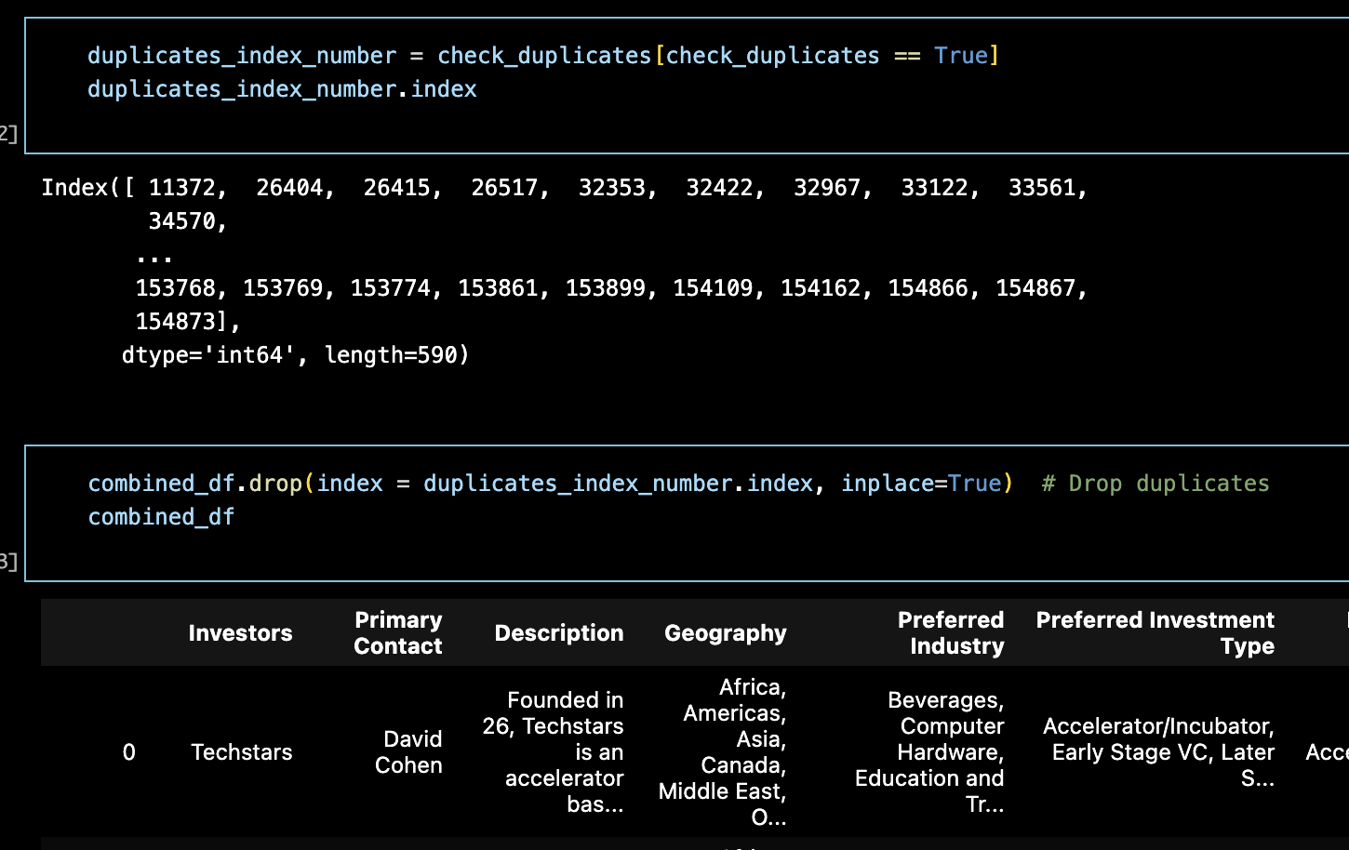
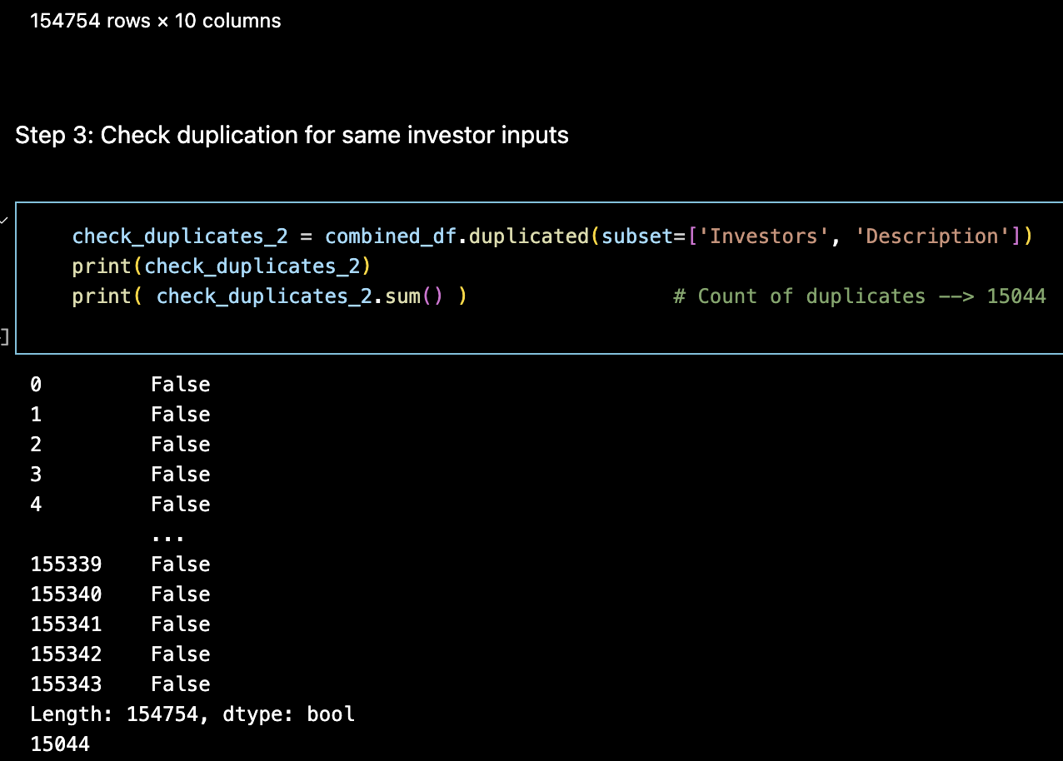
Remove duplicates & invalid records

Slide 14
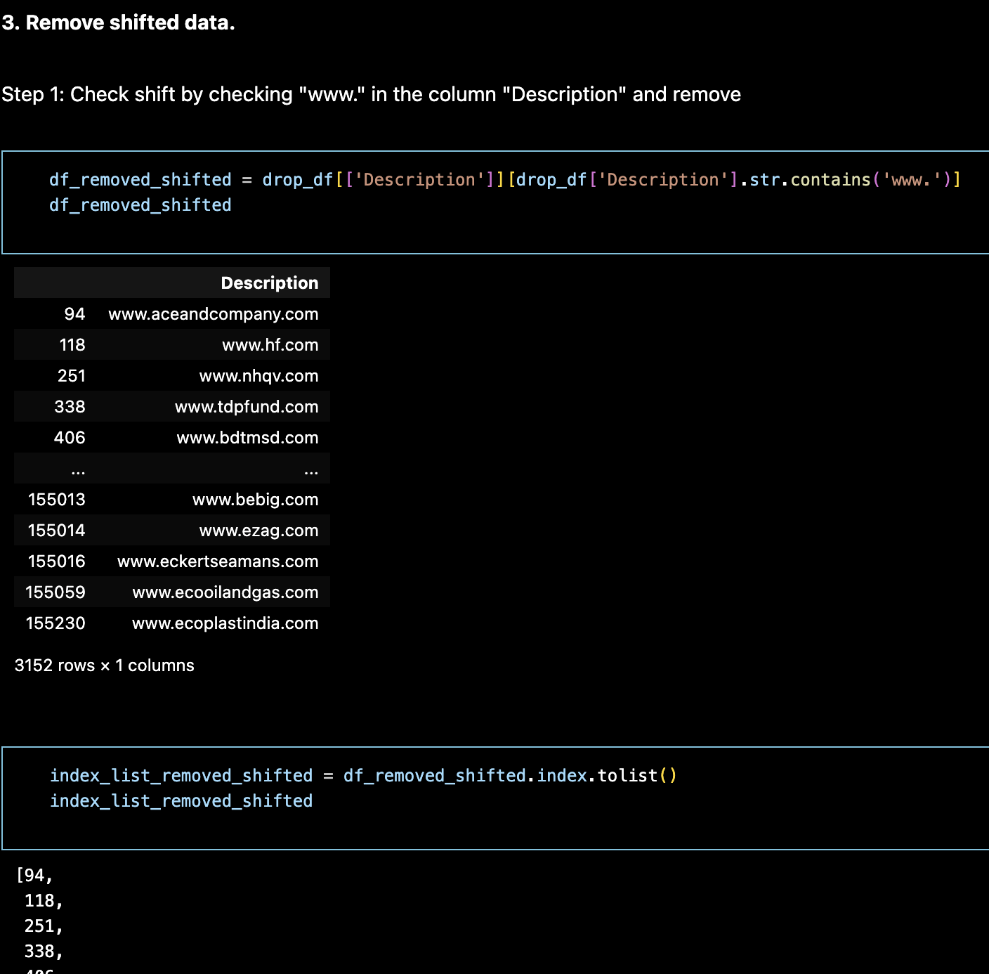
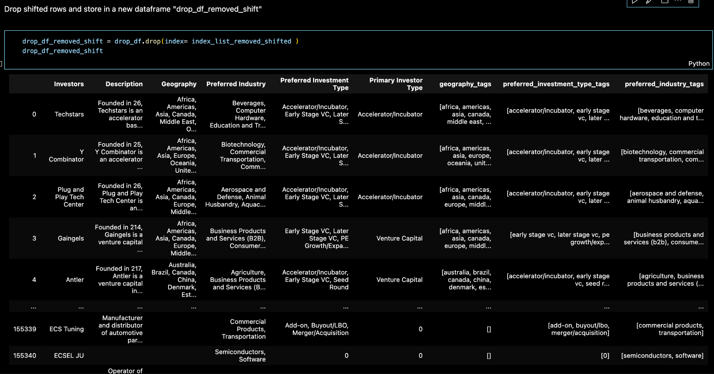
Handle missing values
Remove shifted data.

Slide 15
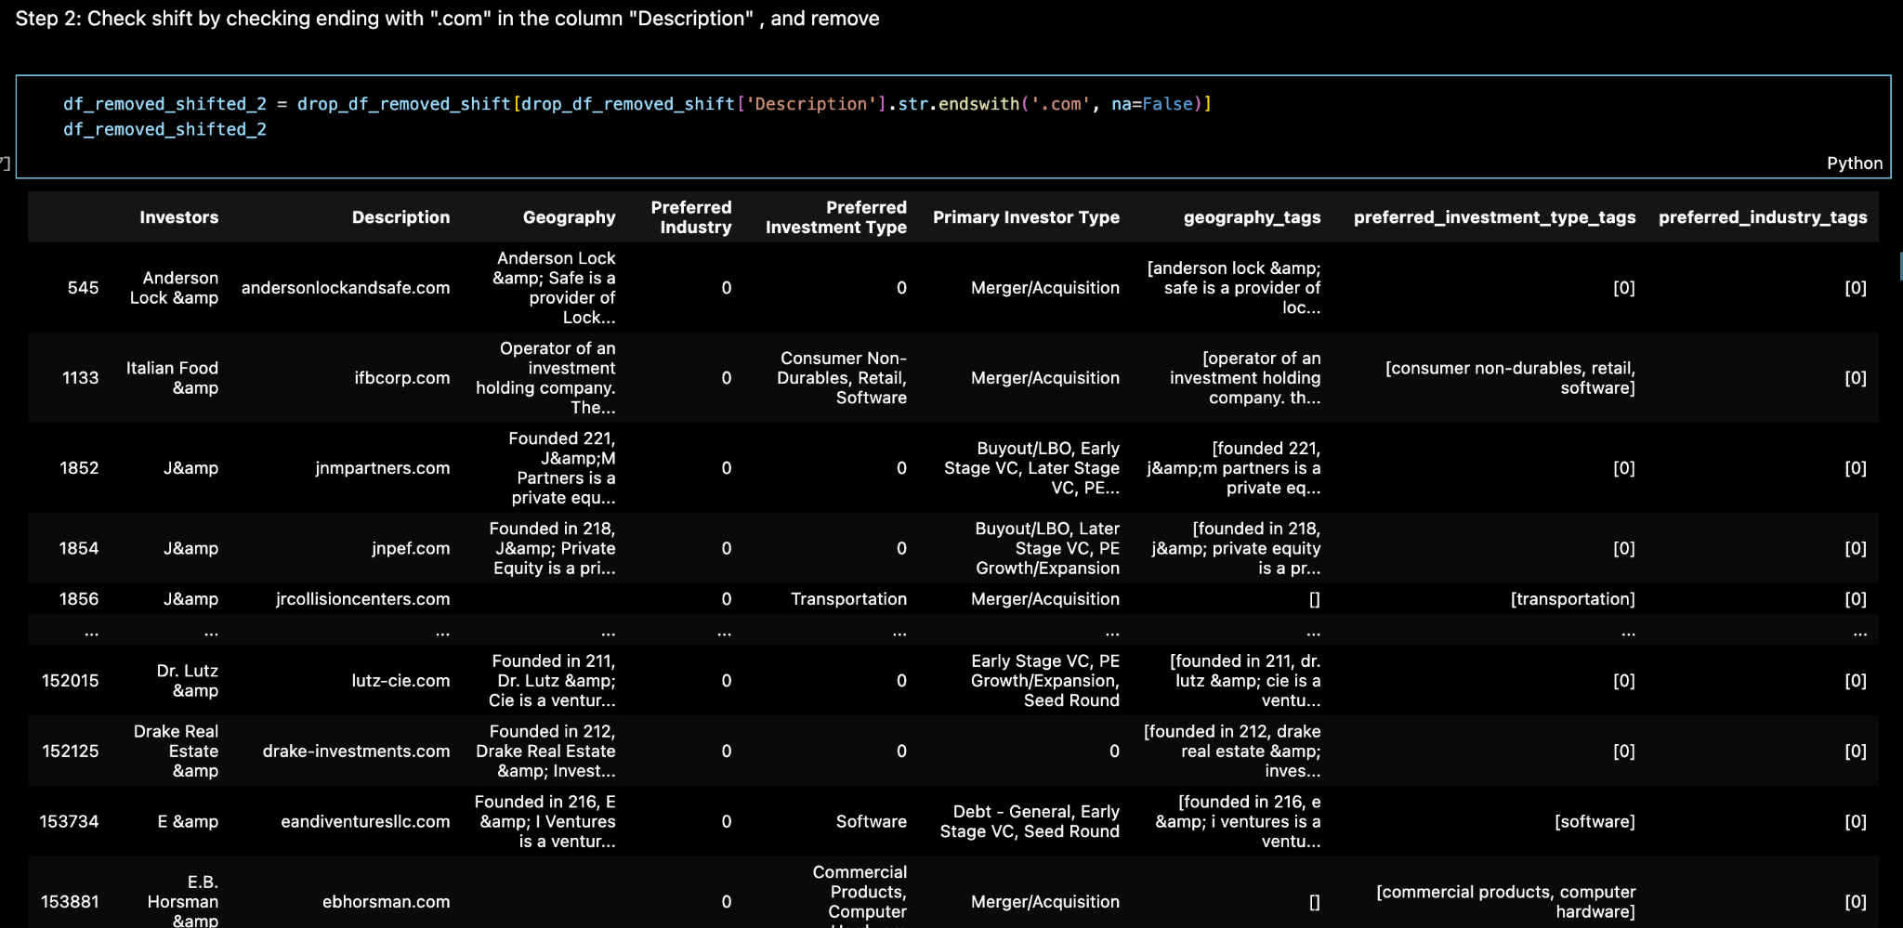
Handle missing values
Remove “.com”

Slide 16
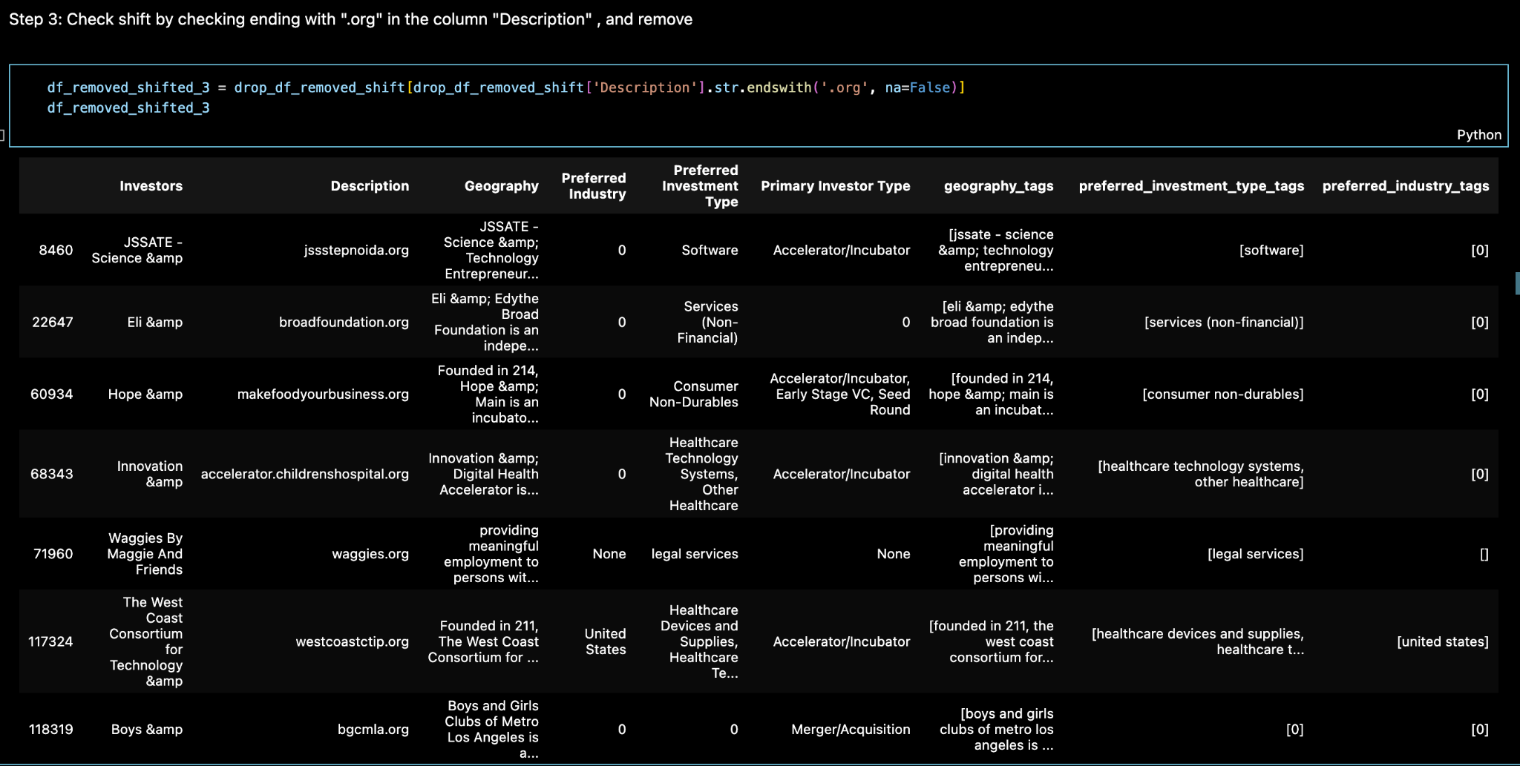
Handle missing values
Remove “.org”

Slide 17
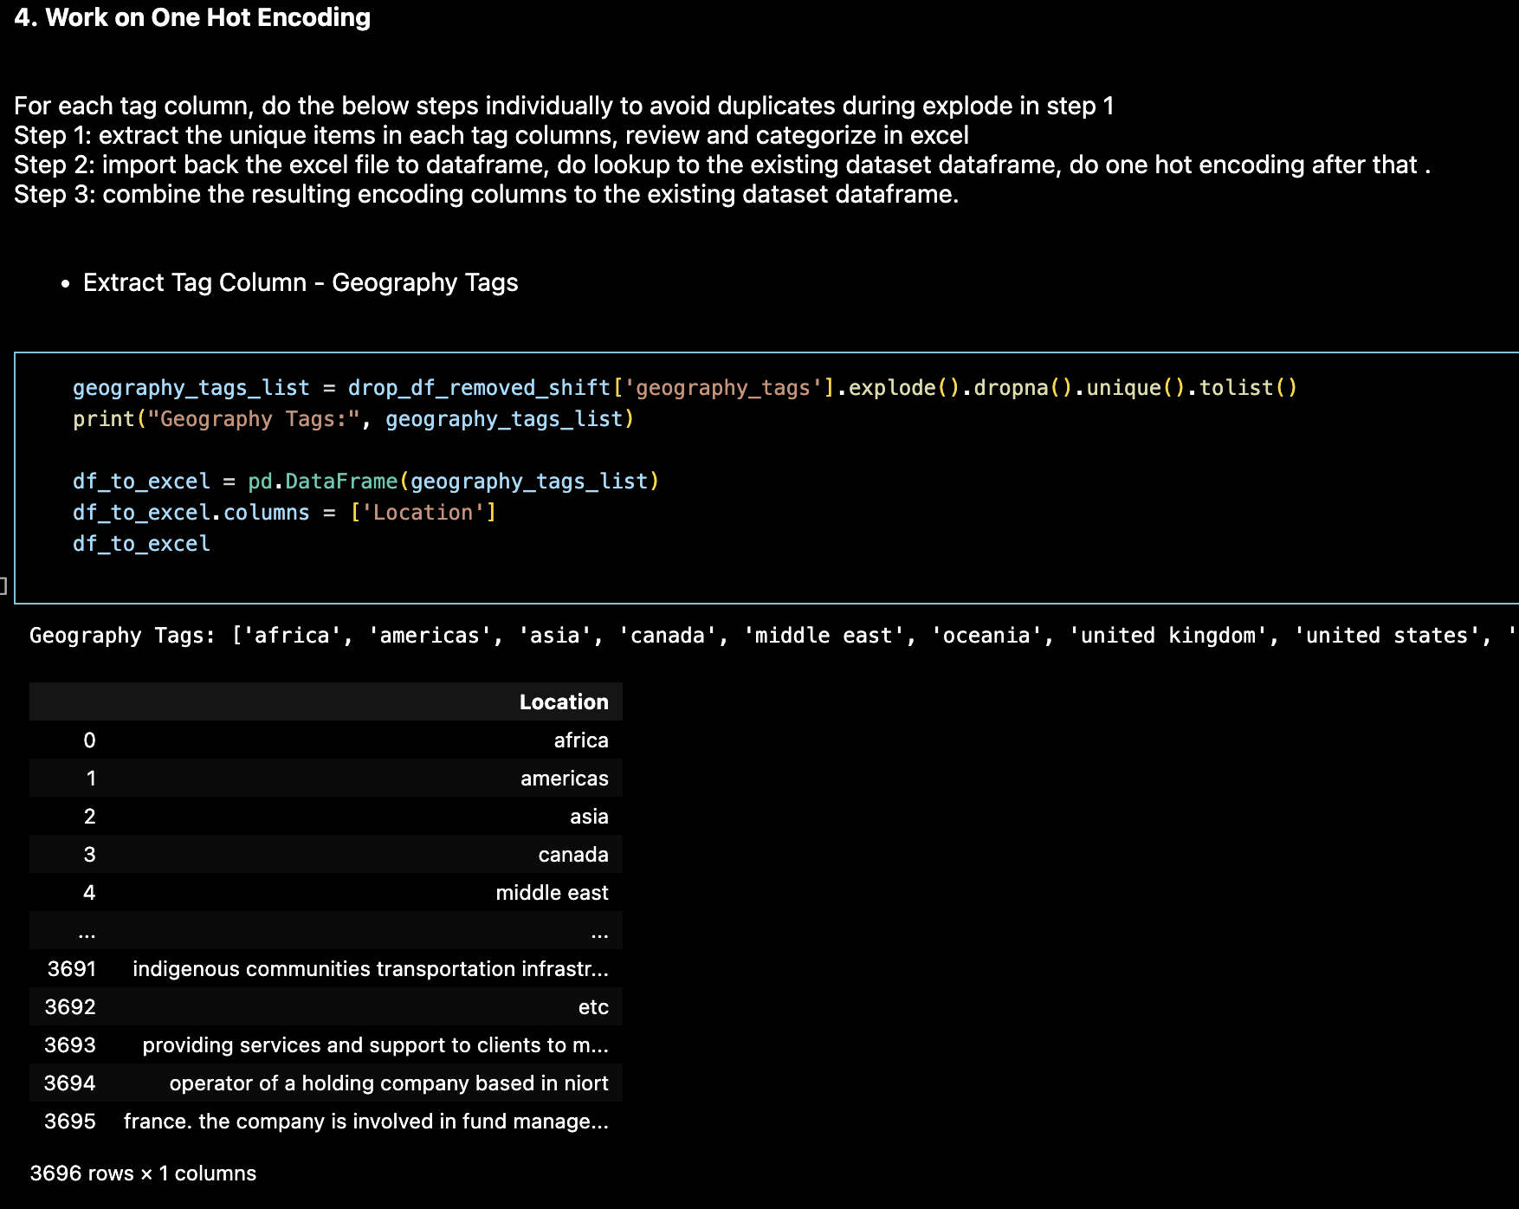
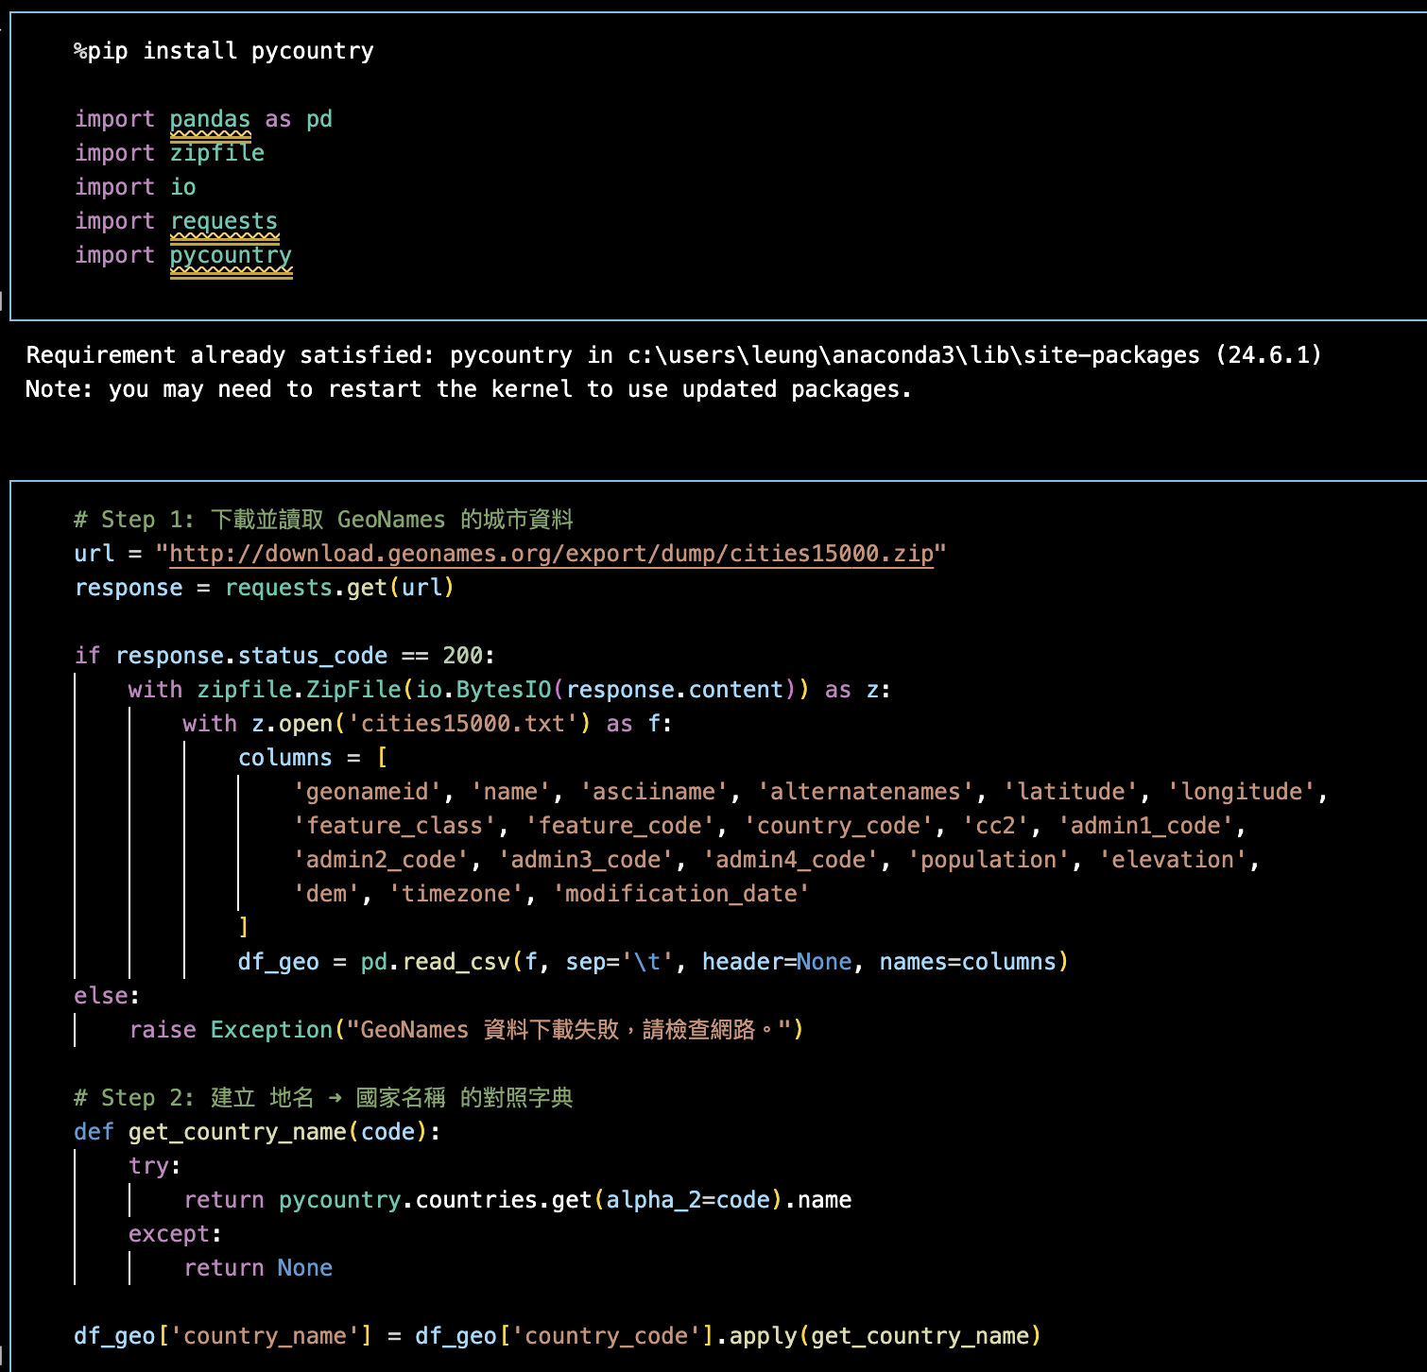
Standardize textual tags into structured fields
3. Work on One Hot Encoding: Geography Tags

Slide 18
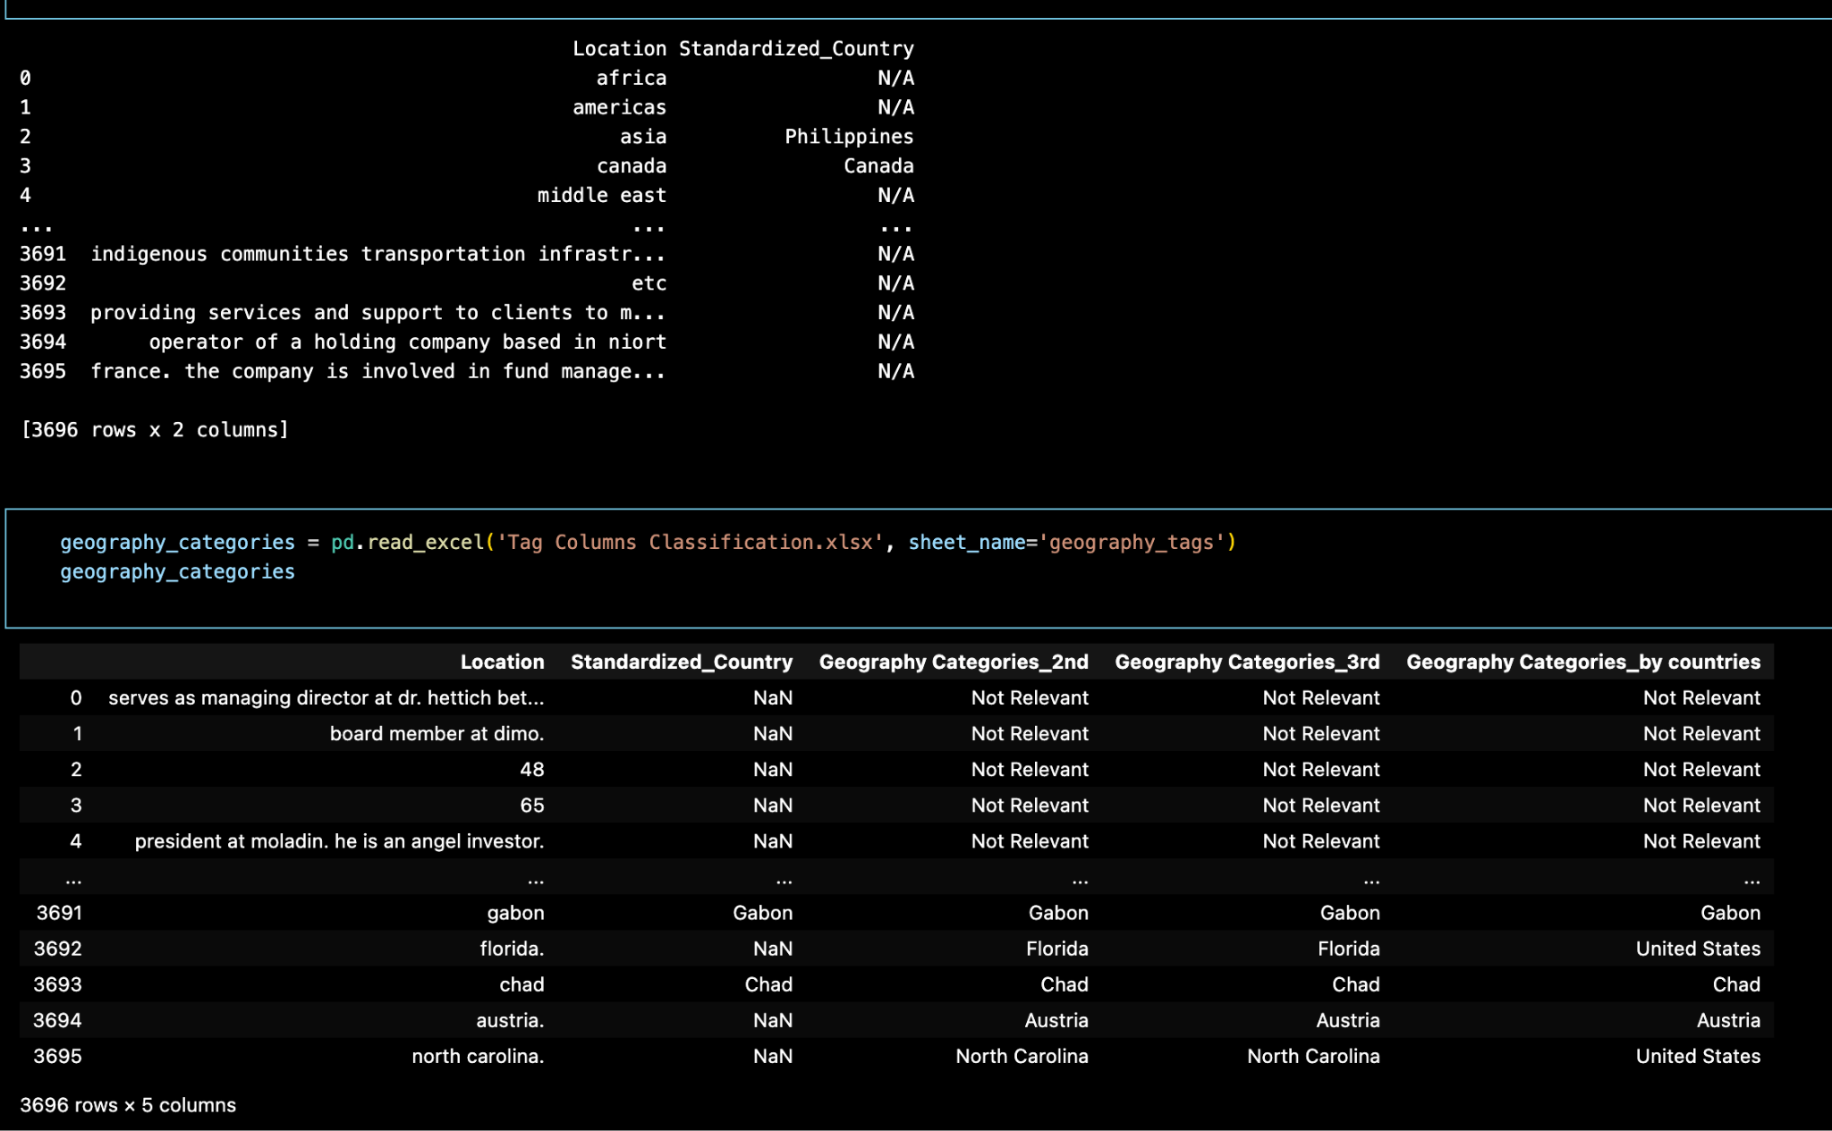
Standardize textual tags into structured fields
Extract Tag Column -
Geography Tags

Slide 19
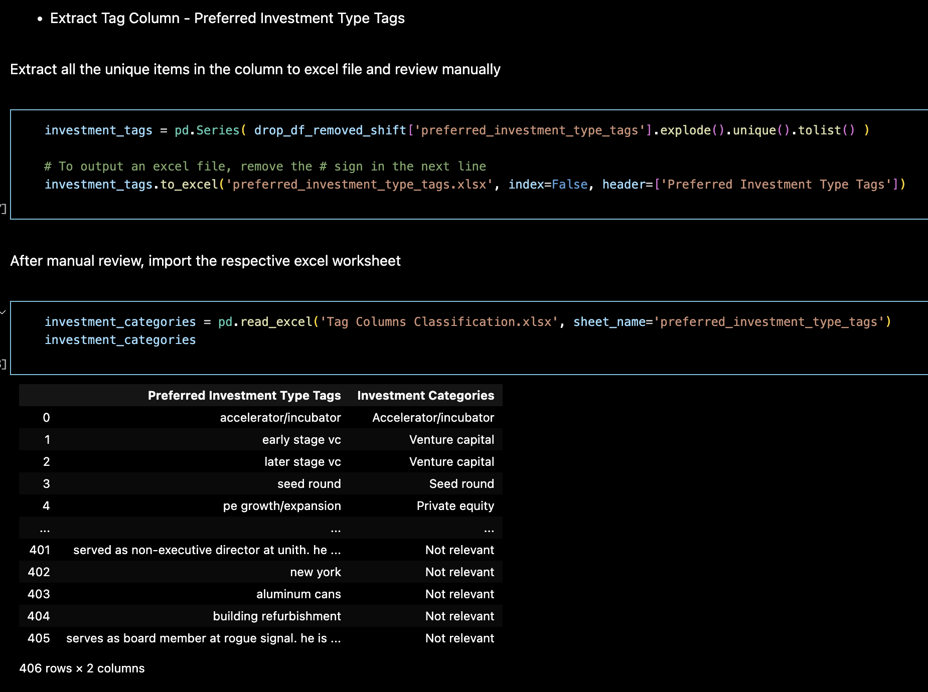
Standardize textual tags into structured fields
Extract Tag Column -
Preferred Investment Type Tags

Slide 20
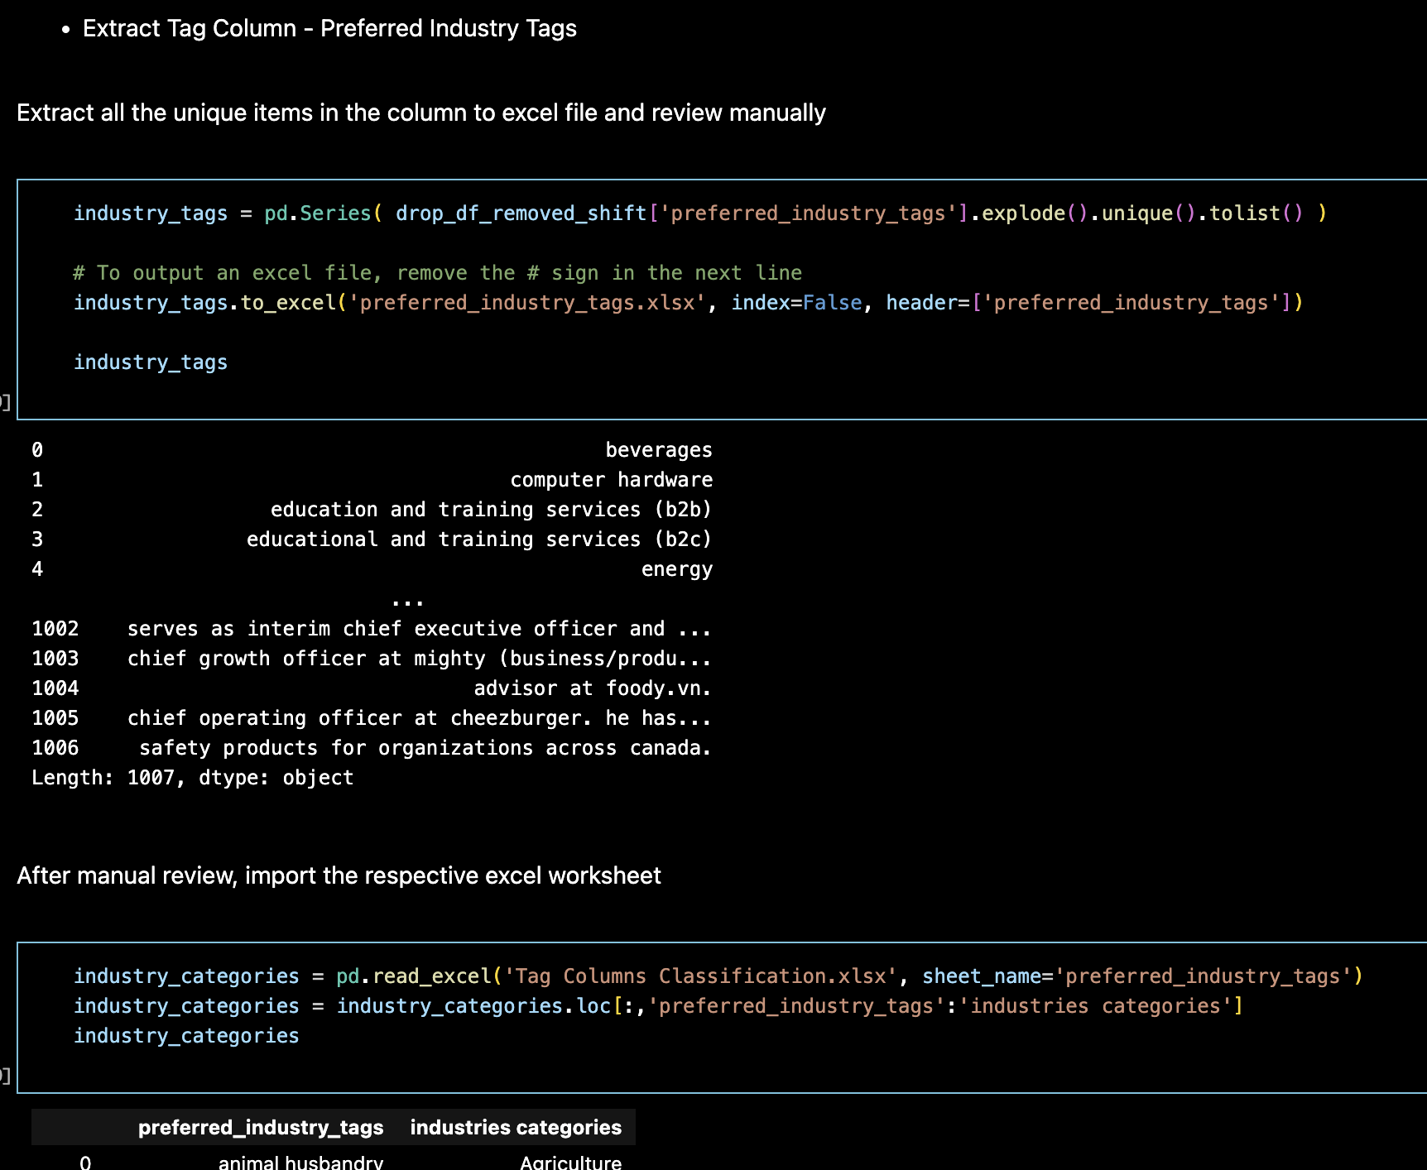
Standardize textual tags into structured fields
Extract Tag Column -
Preferred Industry Tags

Slide 21
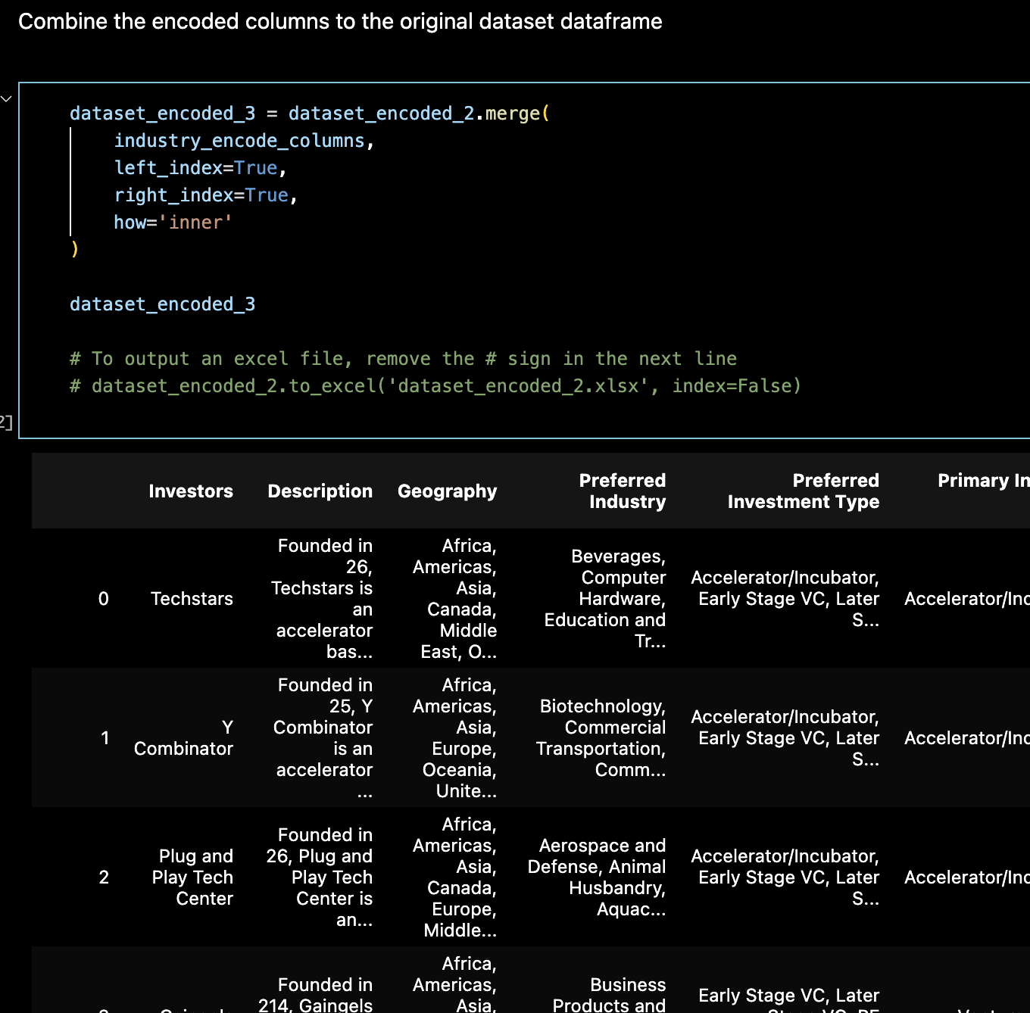
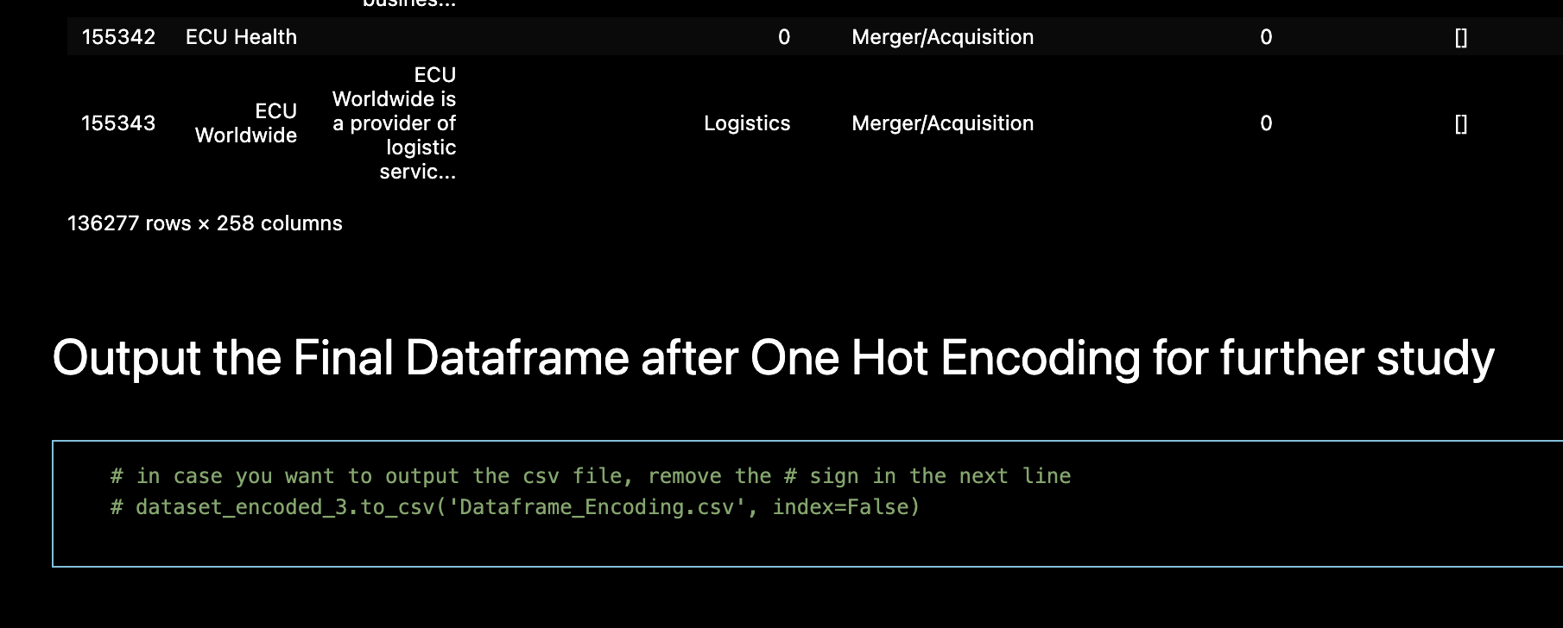
Output the Final Dataframe
after One Hot Encoding for further study
Combine the encoded columns to the original dataset dataframe

Slide 22
02
Data Insights
(EDA)

Slide 23
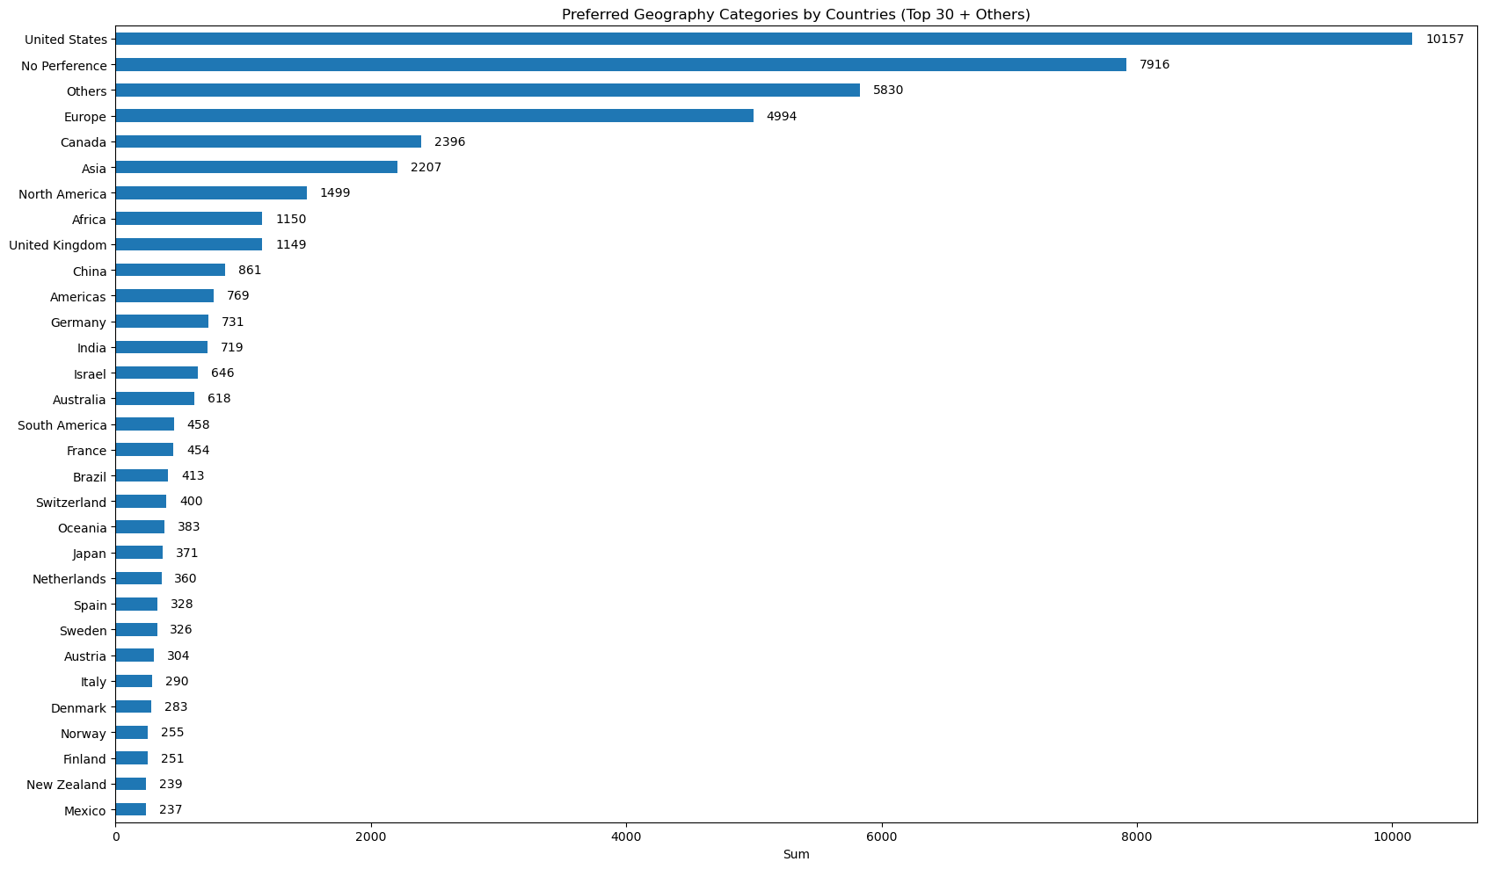
‘Preferred Geography Categories’
Top 1: US (10,157)
Top 2: Europe (4,994)
Top 3: Canada (2,396)

Slide 24
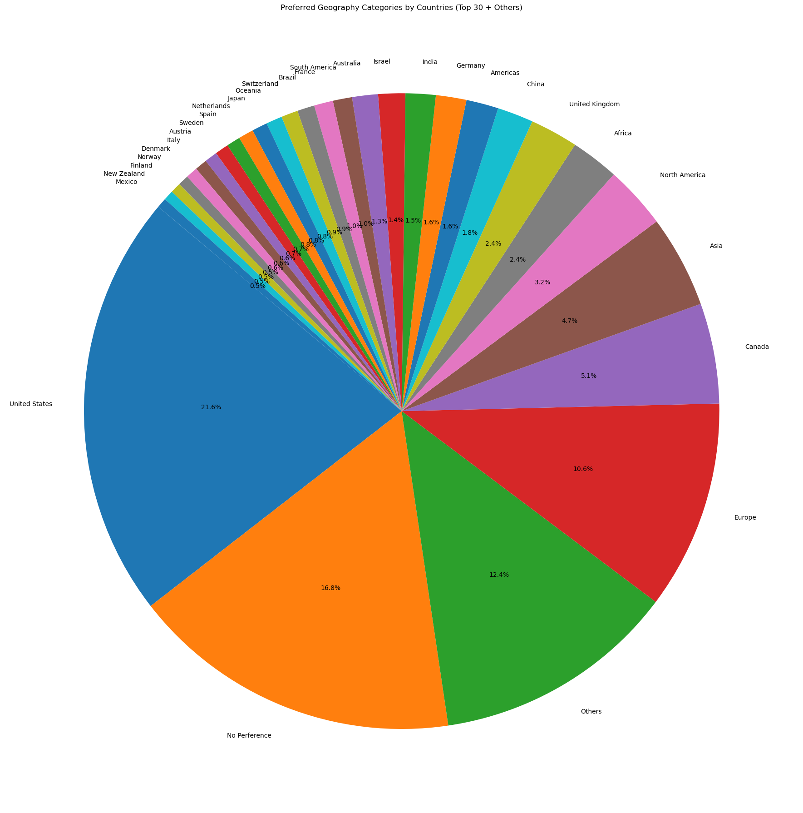
‘Preferred Geography Categories’
Top 1: US (21.60%)
Top 2: Europe (16.80%)
Top 3: Canada (12.40%)

Slide 25
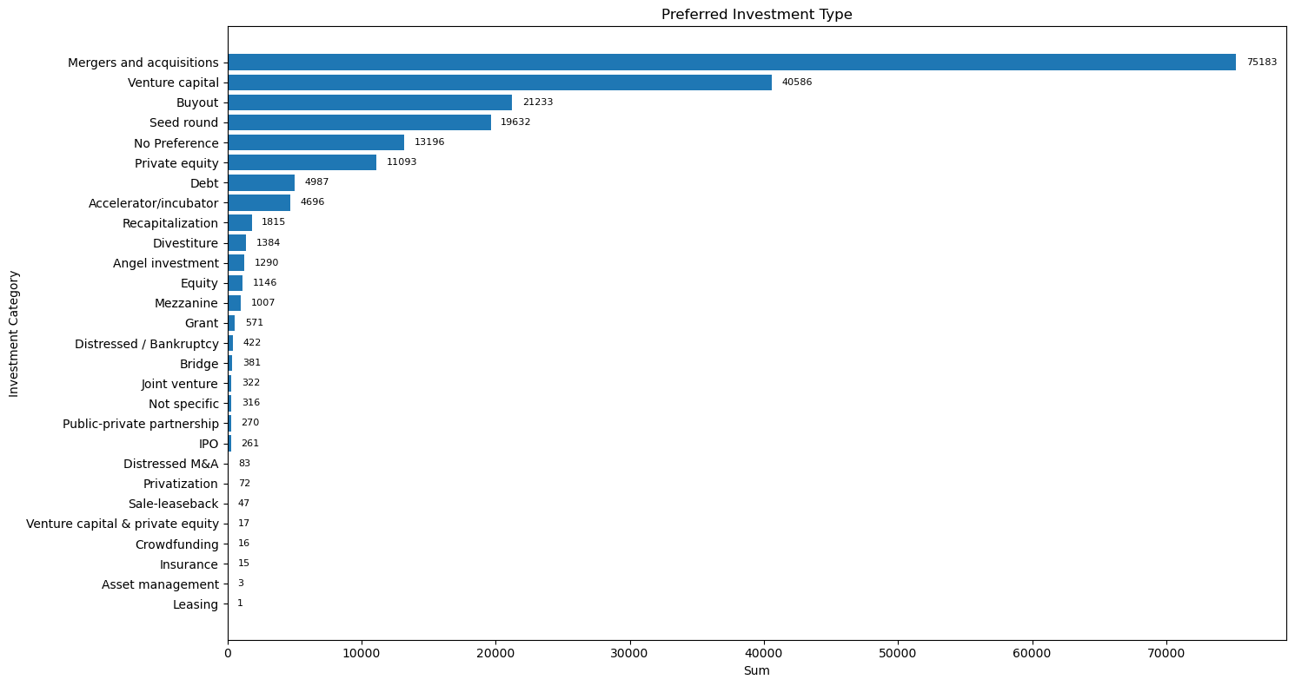
‘Preferred Investment Type’
Top 1: Mergers & Acquisition
(75,183)
Top 2: Venture Capital
(40,586)
Top 3: Buyout (21,233)

Slide 26
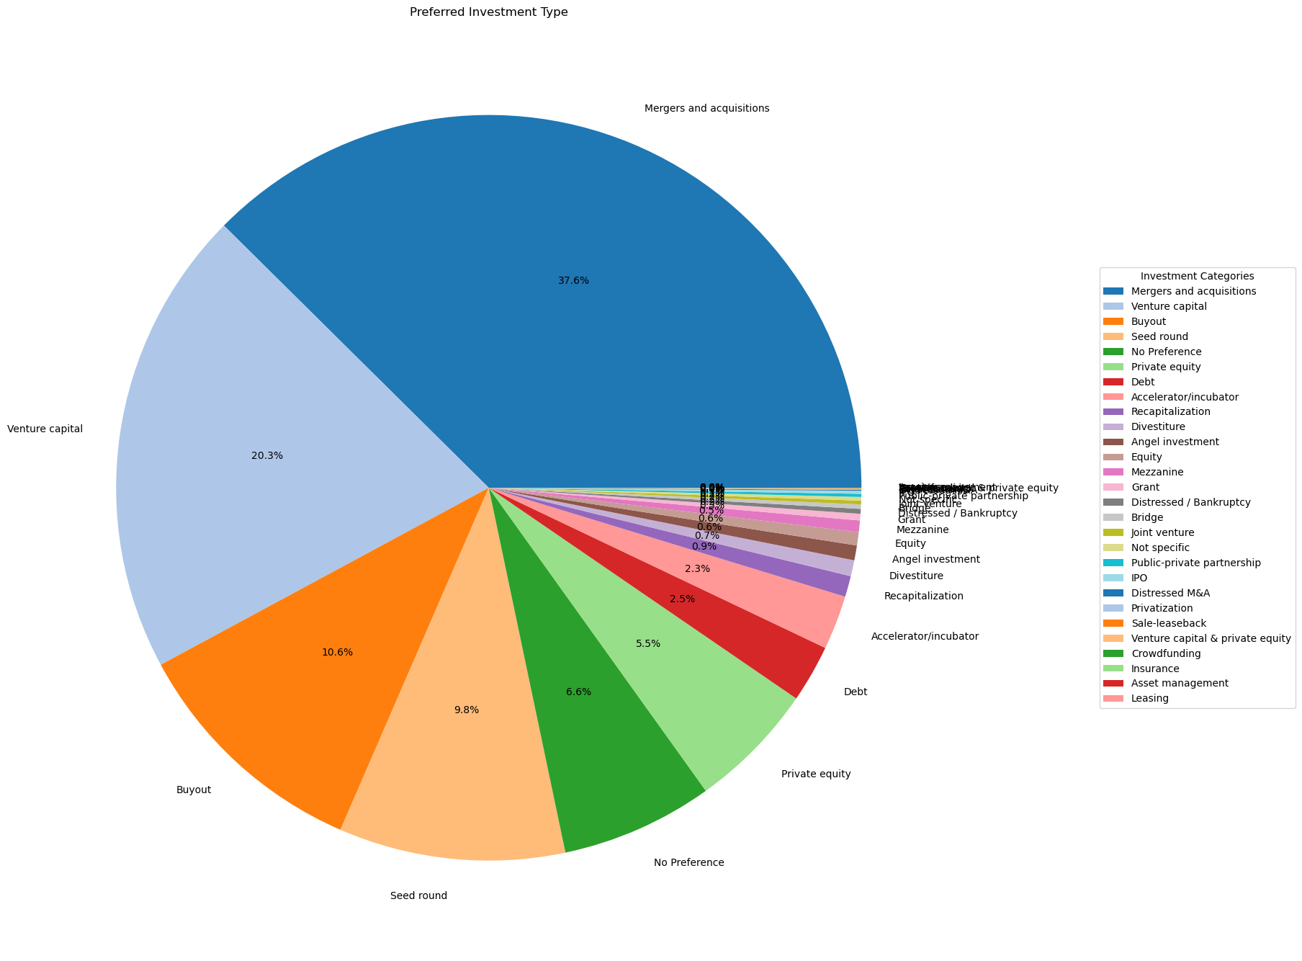
‘Preferred Investment Type’
Top 1: Mergers & Acquisition
(37.6%)
Top 2: Venture Capital
(20.3%)
Top 3: Buyout (10.6%)

Slide 27
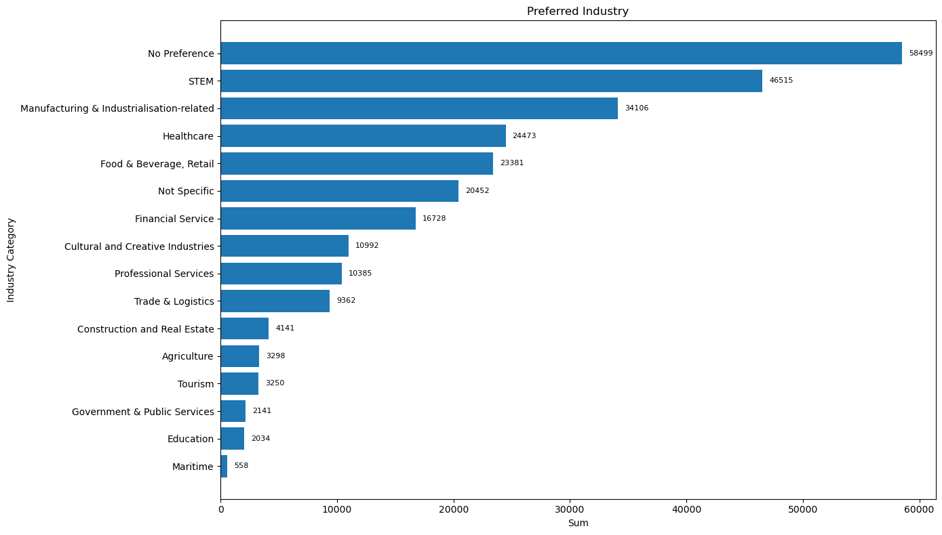
‘Preferred Industry Type’
Top 1: STEM (46,515)
Top 2: Manufacturing & Industrialisation-related (34,106)
Top 3: Healthcare (24,473)

Slide 28
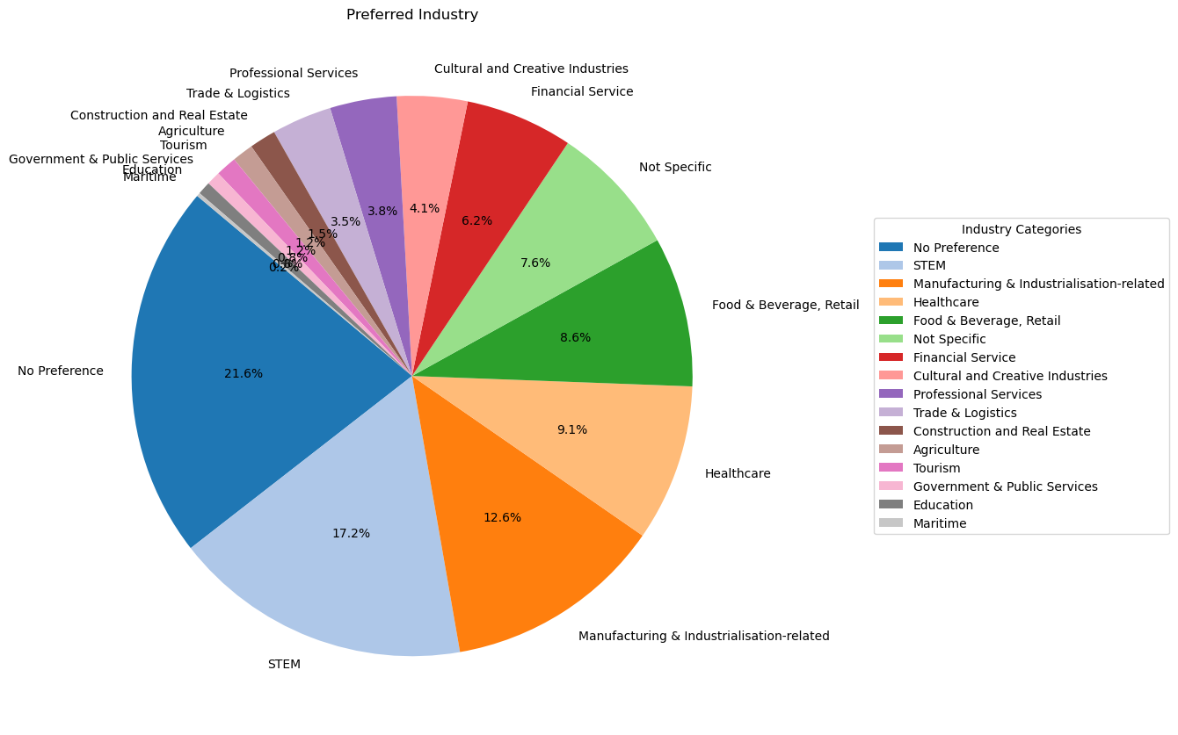
‘Preferred Industry Type’
Top 1: STEM (17.2%)
Top 2: Manufacturing & Industrialisation-related (12.6%)
Top 3: Healthcare (9.1%)

Slide 29
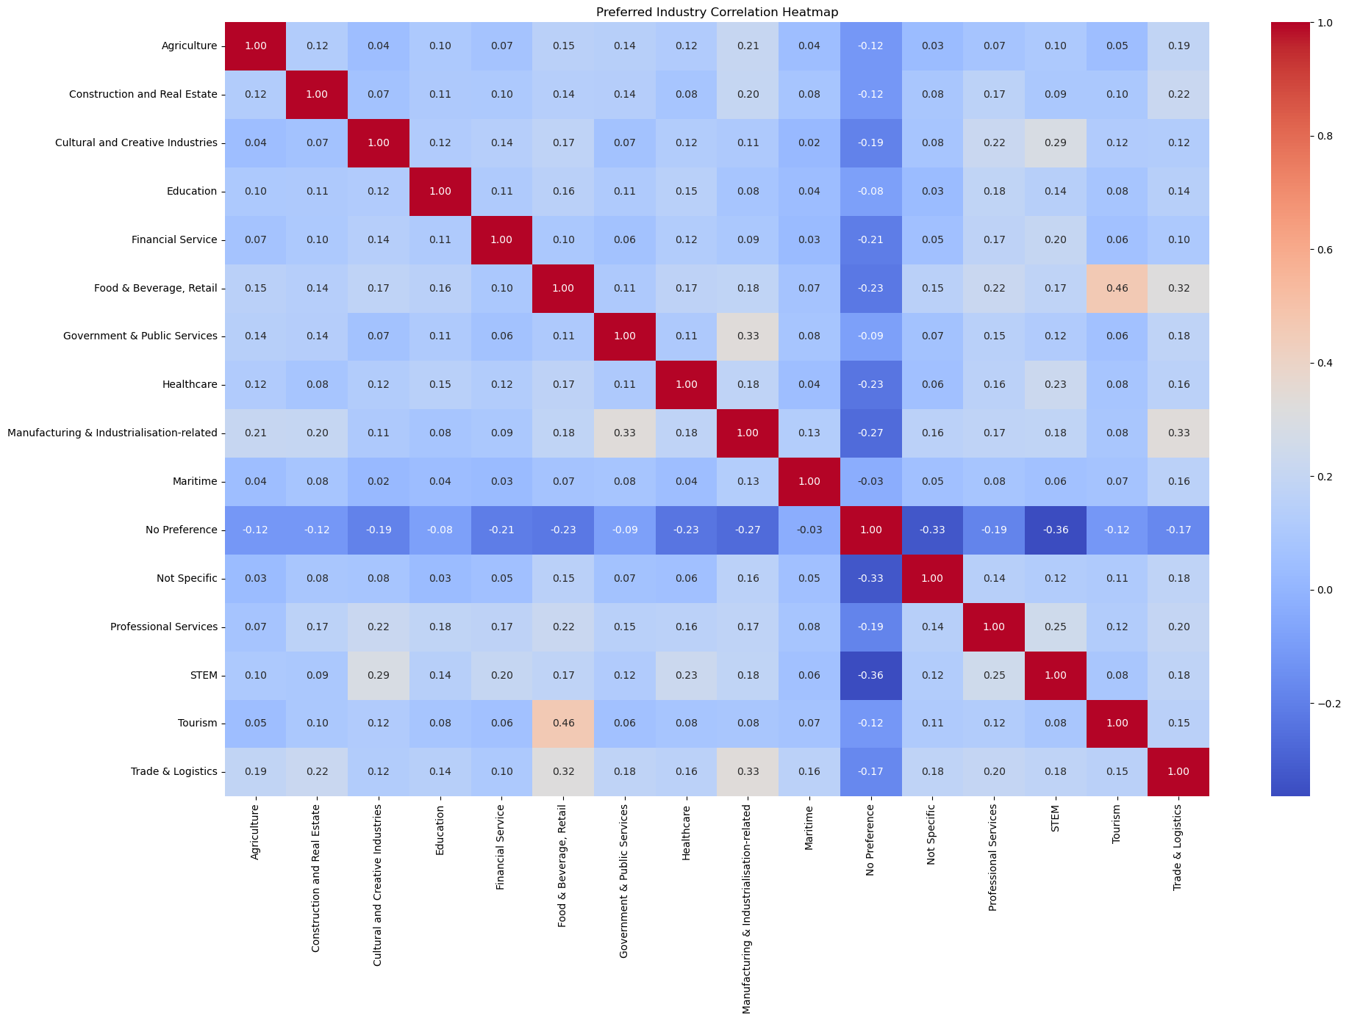
‘Preferred Industry Type’: Correlation
Tourism &
Food & Beverage & Retail
=0.46
(Moderate Correlation)

Slide 30
Data Visualisation:
Tableau

Slide 31
Overview of Tableau
By Country
Dashboard 01
By Investment Type
By Industry
Dashboard 02
Dashboard 03
Tableau

Slide 32



Overview of Tableau: Main takeaways
 | Main takeaways
Dashboard 01: by Country | North America (the US, Canada) = the most popular Philippines = the second most popular
Dashboard 02: by Investment Type | Merger & Acquisitions = the most popular Venture Capital = the second most popular
Dashboard 03: by Industry | STEM = the most popular Manufacturing & Industrialisation-related = the second most popular

Slide 33
03
Machine Learning

Slide 34
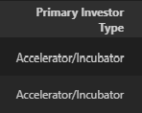
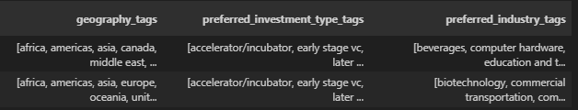
Machine Learning
The 3 main tags columns
sub-tags
Clustering | Investor Cluster (investor + their main preference of sub-tags) Tag Cluster (sub-tags) → Recommendation of relevant sub-tags
Association Rule | Among the 3 main tags Between “Primary Investor Type” and “Investment Type”
Supervised Learning | Use 2 main tags column to forecast the Remaining 1 main tag Column

Slide 35
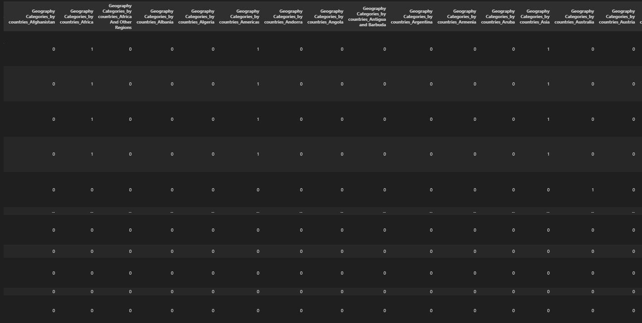
Machine Learning - Clustering
Investor Cluster (investor + their main preference of sub-tags)
One-Hot encode all the sub tags

Slide 36
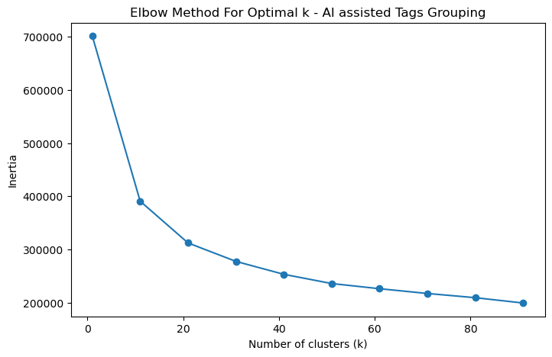
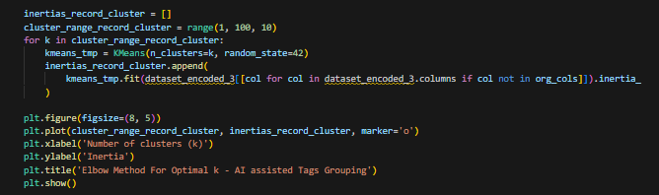
Machine Learning - Clustering
Investor Cluster (investor + their main preference of sub-tags)
K-means was used.
Optimal k (20) was determined by Elbow Method

Slide 37
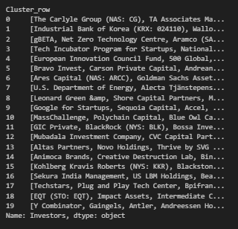
Machine Learning - Clustering
Investor Cluster (investor + their main preference of sub-tags)
The list of investors in their respective clusters was extracted.

Slide 38
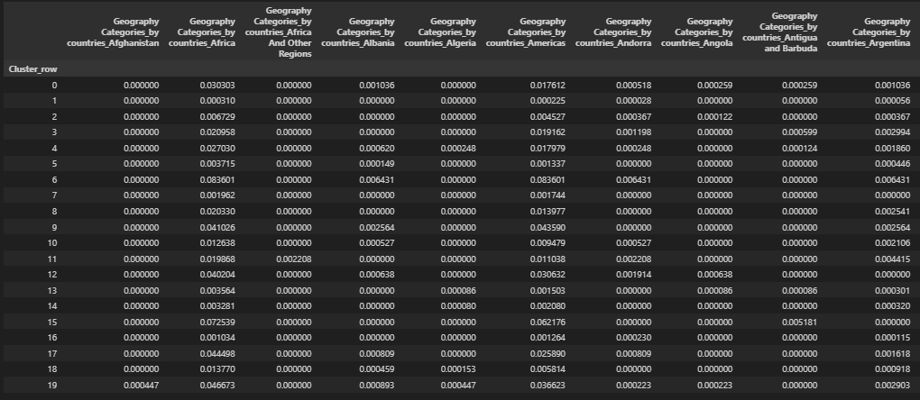
Machine Learning - Clustering
Investor Cluster (investor + their main preference of sub-tags)
Next step
To find the main preference of sub tags in each cluster.
Firstly, the average number of occurrence of sub tags was calculated in each cluster.

Slide 39
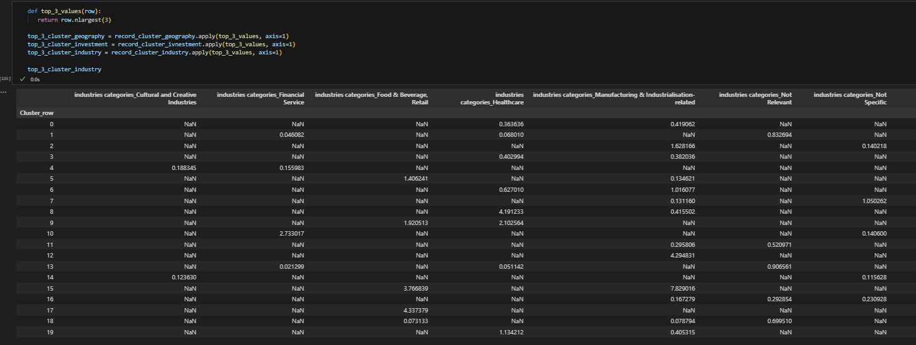
Machine Learning - Clustering
Investor Cluster (investor + their main preference of sub-tags)
Secondly, the top 3 sub tags of each main tag was filtered in each cluster

Slide 40
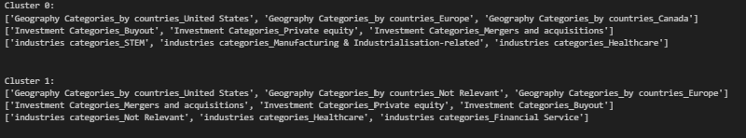
Machine Learning - Clustering
Investor Cluster (investor + their main preference of sub-tags)
The final 20 results were outputed.
Each cluster displayed their respective top 3 preference in Geography, Investment Type and Industry.
To put 2 clusters for example as below:

Slide 41
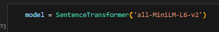
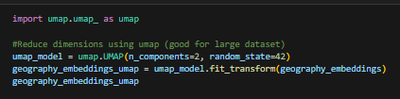
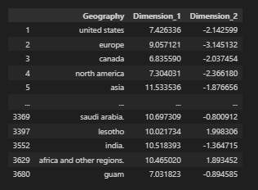
Machine Learning - Clustering
2. Tag Cluster (sub-tags) → Recommendation of relevant sub-tags
Embedding
For each main tag, all it’s sub-tags were embedded by sentence transformer and arrays of vectors were returned.
Dimensionality Reduction
UMAP was used to reduce the dimensions of vectors down to only 2 dimensions while preserving as much of the dataset’s structure and characteristics as possible.

Slide 42
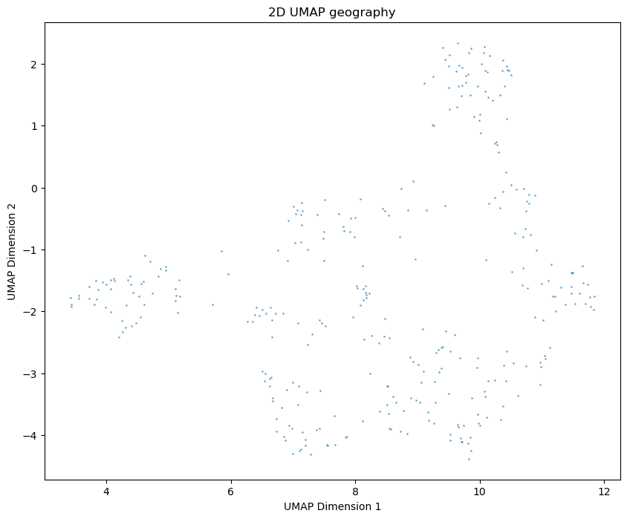
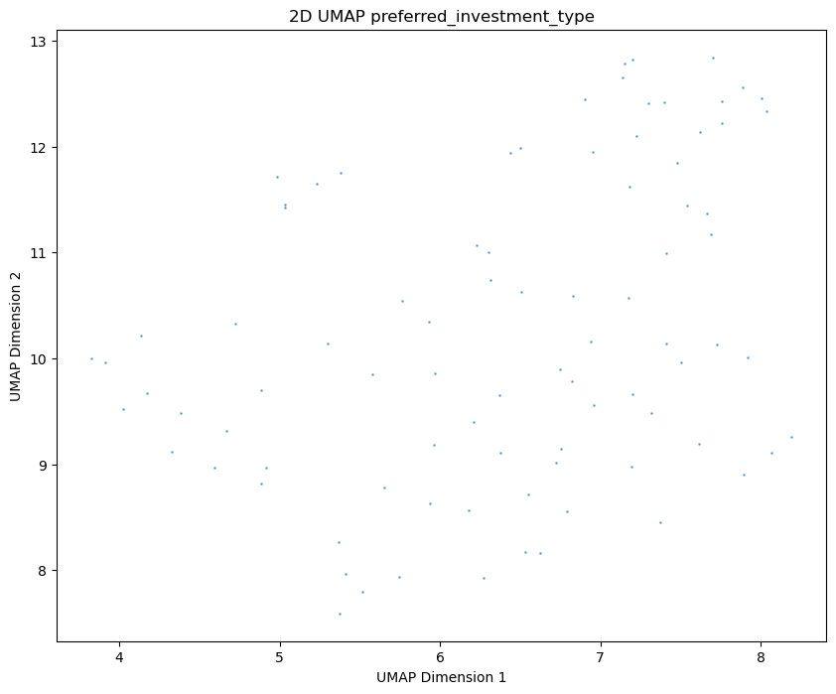
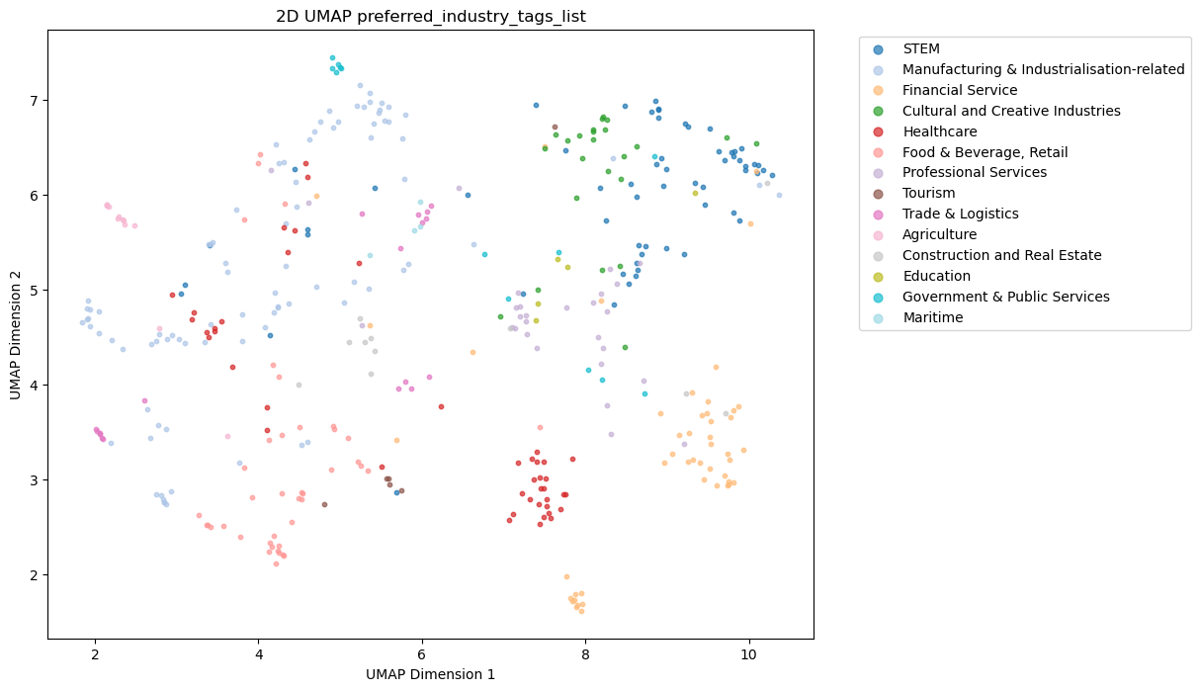
Machine Learning - Clustering
2. Tag Cluster (sub-tags) → Recommendation of relevant sub-tags
Dimensionality Reduction
To visualize the outcome generated by UMAP for the sub tags in each main tag.
The outcome seemed generally scattered.
However, when a brief categorization was assisted by LLM
(e.g. the color legend of Industry), the scattered points were indeed grouped.
Geography
Investment Type
Industry

Slide 43
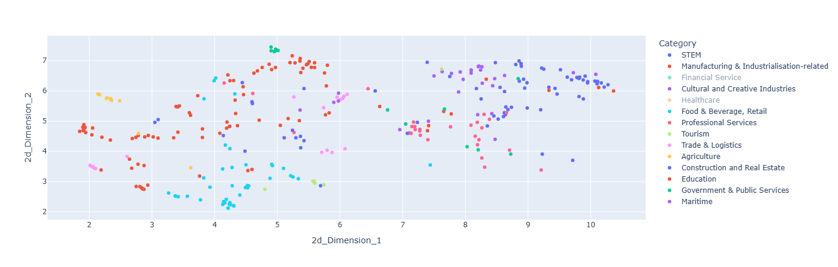
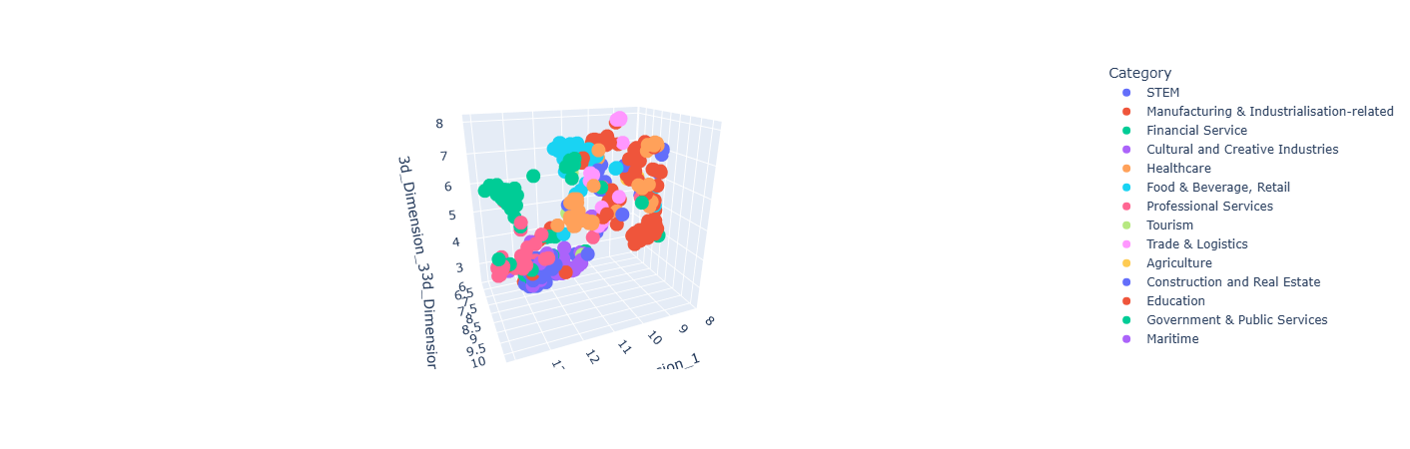
Machine Learning - Clustering
2. Tag Cluster (sub-tags) → Recommendation of relevant sub-tags
Dimensionality Reduction
To visualize the outcome generated by UMAP for the sub tags in each main tag.
To better visualize the distribution,
‘Plotly’ module was used.
Industry

Slide 44
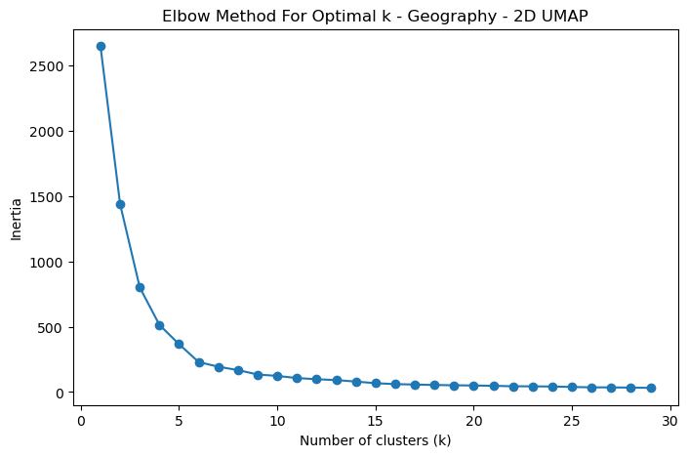
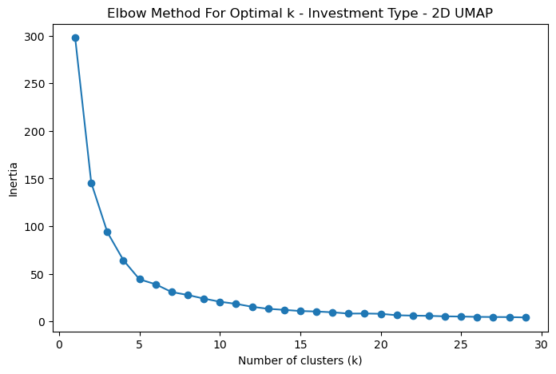
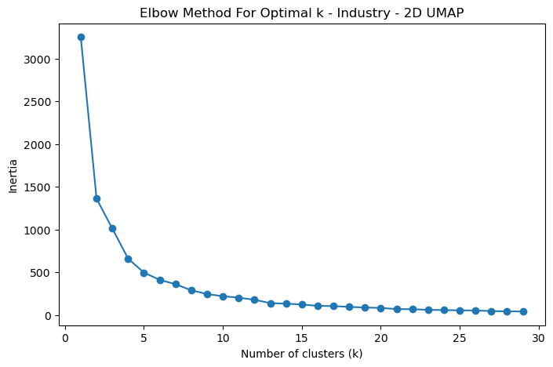
Machine Learning - Clustering
2. Tag Cluster (sub-tags) → Recommendation of relevant sub-tags
Cluster after Dimensionality Reduction to 2D
K-means and Elbow method were again used.
The following optimal numbers of K were found.
Geography: 6
Investment Type: 5
Industry: 5
Geography
Investment Type
Industry

Slide 45
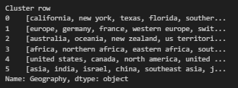
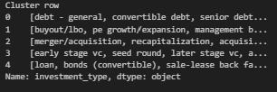
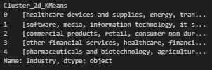
Machine Learning - Clustering
2. Tag Cluster (sub-tags) → Recommendation of relevant sub-tags
Cluster after Dimensionality Reduction to 2D
K-means and Elbow method were again used.
The following optimal numbers of K were found.
Geography: 6
Investment Type: 5
Industry: 5
Sub Tags are clustered, which can be used for recommendation to investors of similar interests.
Geography
Investment Type
Industry

Slide 46
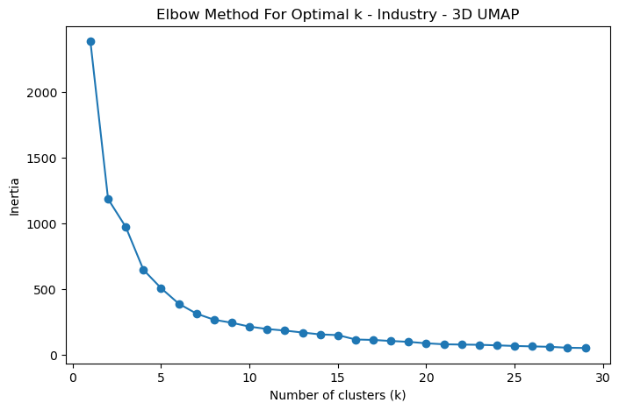
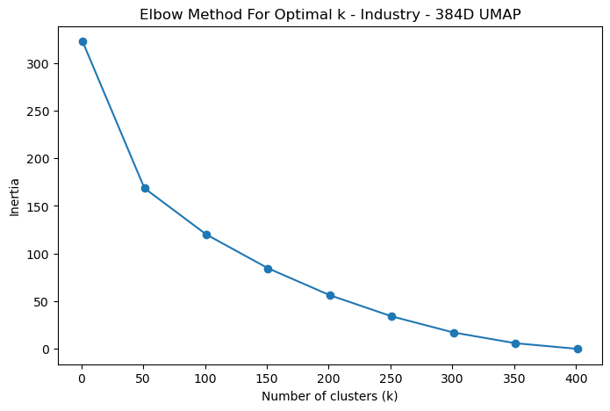
Machine Learning - Clustering
2. Tag Cluster (sub-tags) → Recommendation of relevant sub-tags
A deeper look at the Dimensionality Reduction Process
Why it matters? Improve interpretability and computational efficiency
The following optimal numbers of K were found.
Industry(2 dimensions): 5
Industry(3 dimensions): 7
Industry(384 dimensions): 350 350 clusters are hard to interpret by human handling perspective
Industry (2 dimensions)
Industry (3 dimensions)
Industry (384 dimensions)

Slide 47
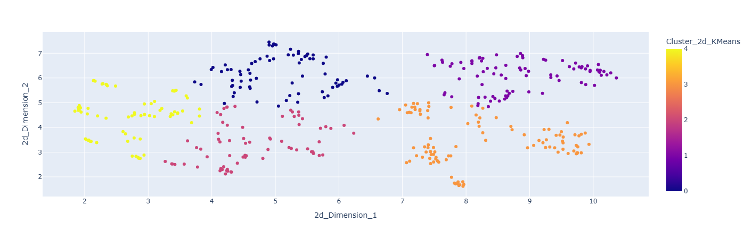

Machine Learning - Clustering
2. Tag Cluster (sub-tags) → Recommendation of relevant sub-tags
A deeper look at the Dimensionality Reduction Process
Why it matters? Improve interpretability and computational efficiency
The following optimal numbers of K were found.
Industry(2 dimensions): 5
Industry(3 dimensions): 7
Industry(384 dimensions): 350 350 clusters are hard to interpret by human handling perspective
Industry (2 dimensions)
Industry (384 dimensions)

Slide 48
Machine Learning - Association Rule
Association Rule | Among the 3 main tags Between “Primary Investor Type” and “Investment Type”
1. Among the 3 main tags
2. Between “Primary Investor Type” and “Investment Type”
Encode
Apriori Algorithm
Basically, it helps to find the frequent itemsets (sub tags), which is used to deduce association for items within the sets (like Set AB : A → B) .

Slide 49
Machine Learning - Association Rule
One-Hot encode all the sub tags

Slide 50

Machine Learning - Association Rule
Apply the Apriori Algorithm
Adjust Parameter
min_support : can be adjusted to a higher level (in this case 0.05) to get frequent itemsets with higher occurrence threshold and thus a higher association for items within sets.
min_threshold : set as 1.0 , which indicates positive association between items within sets.

Slide 51

Machine Learning - Association Rule
20 association was extracted &
sorted in descending order.
Among the 3 main tags
Between Industry & Investment Type (Green)
STEM → Venture Capital & Seed Round
Manufacturing & Industrialization-related → Mergers and Acquisitions
Within Investment Type (Orange)
Venture Capital & Seed Round
Private Equity & Buyout
A
B
Within Industry (Yellow)
STEM & Healthcare

Slide 52

Machine Learning - Association Rule
2. Between “Primary Investor Type” and “Investment Type”
A
B
12 association was extracted and sorted in descending order.
Light Green: Venture Capital, Seed Round
Orange: Corporation, Mergers and Acquisition

Slide 53

Machine Learning - Supervised Learning
Inputs (Features):
Investment Geography
Investment Industry
Objective:
Multi-Label Classification (22 Categories)
Investment Category
Limitation:
"long-tail"
Extreme Class Imbalance
Notes:
First, our Objective. We are building a model to predict a Investment Category of investor. This is a Multi-Label Classification task, meaning one investor can have several categories.
The Inputs our model will use to make these predictions are the investement Geography and industry.
However, our main challenge is a limitation in the data. We have an Extreme Class Imbalance.
This is also known as a 'long-tail' problem. A few categories are very common, but most are extremely rare. It may not enough data to train the data. We had resampling(Adaptive Synthetic - ADASYN)

Slide 54

Machine Learning - Model 1: Decision Tree
How it Works:
Creates a simple flowchart of "if-then" rules to make a prediction based on the data.
Key Advantage:
Highly interpretable, allowing us to clearly visualize and understand the decision-making logic.
Notes:
We builded 3 model. Let, We started with the Decision Tree. This model works like a simple flowchart, learning a series of 'if-then' rules directly from the data. Its main advantage is its transparency; we can easily see exactly how it arrives at a decision, which makes it an excellent baseline for our project."

Slide 55

Machine Learning - Model 2: Random Forest
How it Works:
An ensemble model that combines hundreds of individual Decision Trees and uses their collective "vote" for the final prediction.
Key Advantage:
Delivers high accuracy and stability by leveraging the "wisdom of the crowd," which makes the model robust and reliable.
Notes:
"Next, we used a Random Forest. This model takes the basic Decision Tree concept and elevates(en~la~face) it by building an entire 'forest' of them. It then combines their predictions through a voting process. This ensemble approach gives us a significant boost in accuracy and stability, creating a very powerful and robust model."

Slide 56

Machine Learning - Model 3: CatBoost
How it Works:
A state-of-the-art model that builds trees sequentially, where each new tree is expertly trained to correct the errors of the previous ones.
Key Advantage:
Features a sophisticated, built-in method for handling categorical data (like 'Region' or 'Product Type'), which often leads to superior performance.
Notes:
"Finally, we deployed CatBoost, our most advanced model. It operates by building a series of trees in a smart sequence, where each tree learns from the mistakes of the one before it. A key advantage of CatBoost is its (so/ph/is/ti/ca/ted)sophisticated , native handling of categorical data. This capability(cap/ability ) often results in superior(sup/er/ior ) predictive performance, making it an extremely effective tool for complex datasets."

Slide 57

Machine Learning - Stratified K-Fold
Notes:
(S~trust~ti~fi~ed)Stratified K-Fold is a variation of K-Fold cross-validation specifically designed for classification problems to maintain the class distribution in each fold. It ensures that each fold has (a~pop~s~ma~ly)approximately the same percentage of samples of each target class as the complete dataset, which is especially important when dealing with imbalanced datasets.

Slide 58
Machine Learning - Hyperparameter Optimization
Tree-structured Parzen Estimator (TPE) - Optuna library
TPE is a hyperparameter optimization algorithm based on Bayesian optimization.
It intelligently learns from every trial, separating the "good" settings from the "bad" ones to find the optimal combination quickly.
Notes:
"To ensure our model achieved its peak performance, we needed to find its optimal configuration. This process is known as hyperparameter optimization, and it is a critical step.
For this task, we leveraged the (Op~tu~na)Optuna library and its Tree-structured (Pa~son)Parzen (S ta may ~tor)Estimator.
At its core, TPE is a (so/ph/is/ti/ca/ted)sophisticated form of (Bay~s~~ing )Bayesian optimization. It builds a model of which settings lead to 'good' results (ver~sus)versus 'bad' ones, allowing it to focus its search on the most promising areas and find the best combination much faster.

Slide 59


Machine Learning - Score
Notes:
First, if you look at the columns for Accuracy and ROC AUC on the left, you'll see a lot of high scores, mostly in the green. At first glance, this looks very promising. It suggests the models are learning patterns effectively.
However, the most important metric for our imbalanced problem is the F1-Score, shown on the right. This score balances precision and recall and gives us the most honest picture of performance, especially for our rare categories.
The model can support (‘merg~ers)‘mergers and (ac~qui~si~tion’)acquisition’. For the other investment, we may need to collect more data from investor or investee. And more clear date for relationship between the geography, industry and the investment, since the data combines multiple investment industries and geographies into a single row for an investor.

Slide 60

Hyperparameter Tuning
Target investment category: Mergers and acquisitions

Slide 61
04
Challenges, Limitations
& Future Works

Slide 62
Challenges
Data Quality Issues:
Substantial incomplete or missing data in rows and columns limits analysis of investor characteristics.
Complexity of Data:
Challenging data preprocessing and cleaning processes. (e.g,. quotations included in columns/tags and incorrect data positions possibly due to delimiter issues)
Scalability and Performance:
The dataset requires significant computational resources.
Limited Context
Lack of proper context in the data may result in misleading conclusions.
Time Constraints:
Insufficient time for further predictive modeling creating or deeper external data analysis.

Slide 63
Current Limitations
Data Consistency
Requires further standardization (e.g., inconsistent data position and format).
Data Granularity
Lack of subdivision in categories like preferred geography (e.g., continents, countries and cities are grouped in one column), limiting detailed analysis.
Missing Data
Handling is still ongoing.
Complex Interrelationships
Difficult to capture the interrelationships among the features in the analysis.
Dependence on Historical Data
The analysis relies on past data, which may not reflect future trends. Consistent monitoring is required.
Computational Constraints
Resource and time limitations restrict the scale and granularity of analysis.

Slide 64
Potential Future Work
Complete the dataset, minimizing not relevant and missing value, ensuring the data is comprehensive.
Add new features for data analysis such as investment budget, risk aversion level and expected potential growth.
Further Implement machine learning models such as Xgboost to predict investors investment trends, preferences and behaviors.
Create a personalized recommendation system
Apply Natural Language Processing (NLP) such as Large Language Models (LLMs) to analyse investor descriptions.
Continuous model optimization for the current machine learning models

Slide 65
05
Project Summary

Slide 66
Project Summary
Used a 150000 row dataset provided by Zenith to conduct investment profile analysis.
Conducted EDA, created an interactive dashboard using Tableau and performed Machine Learning
EDA key findings
USA is the mostly preferred terrority for investment, followed by Europe and Canada.
Merger & Acquisitions is the mostly preferred investment type, ahead of venture capital.
STEM is the hottest preferred investing industry, followed by manufacturing and healthcare.
Created an interactive dashboard by preferred country, investment type and industry type.

Slide 67
Project Summary
Machine Learning
Two unsupervised models were used to analyze and draw insights from the preferred geography, investment types and industry and primary investor types to reveal hidden patterns.
Clustering
Association Rule
Three supervised learning models to predict among preferred geography, investment types and industry.
(i.e Using preferred geography and investment type to predict preferred industry.)
Decision Tree
Random Forest
CatBoost

Slide 68
THANKS!
Do you have any questions?

